Slide 1
CONFIGURE ENDNOTE
Transfering Citations from Endnote to Endnote Web

Slide 2
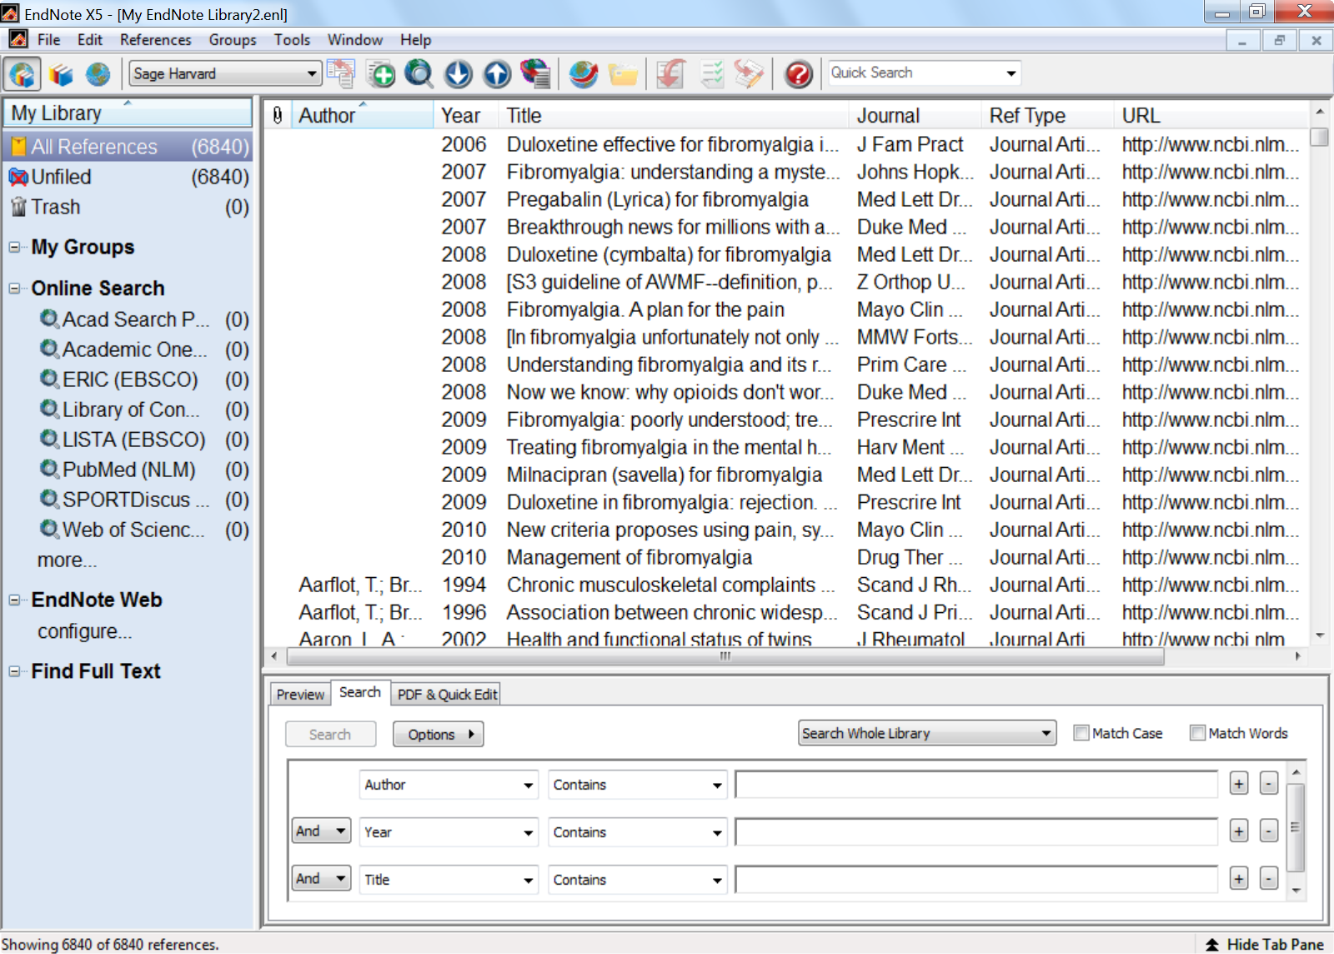
You first have to configure EndNote before you can do transfers to EndNote Web

Slide 3
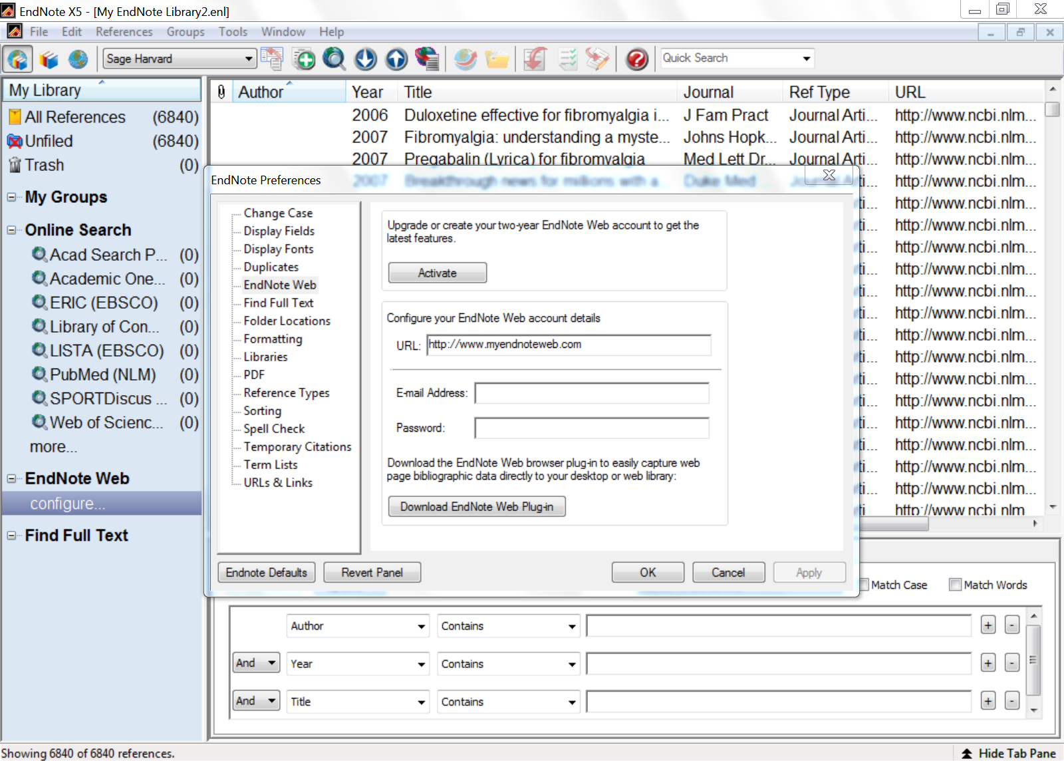

Slide 4
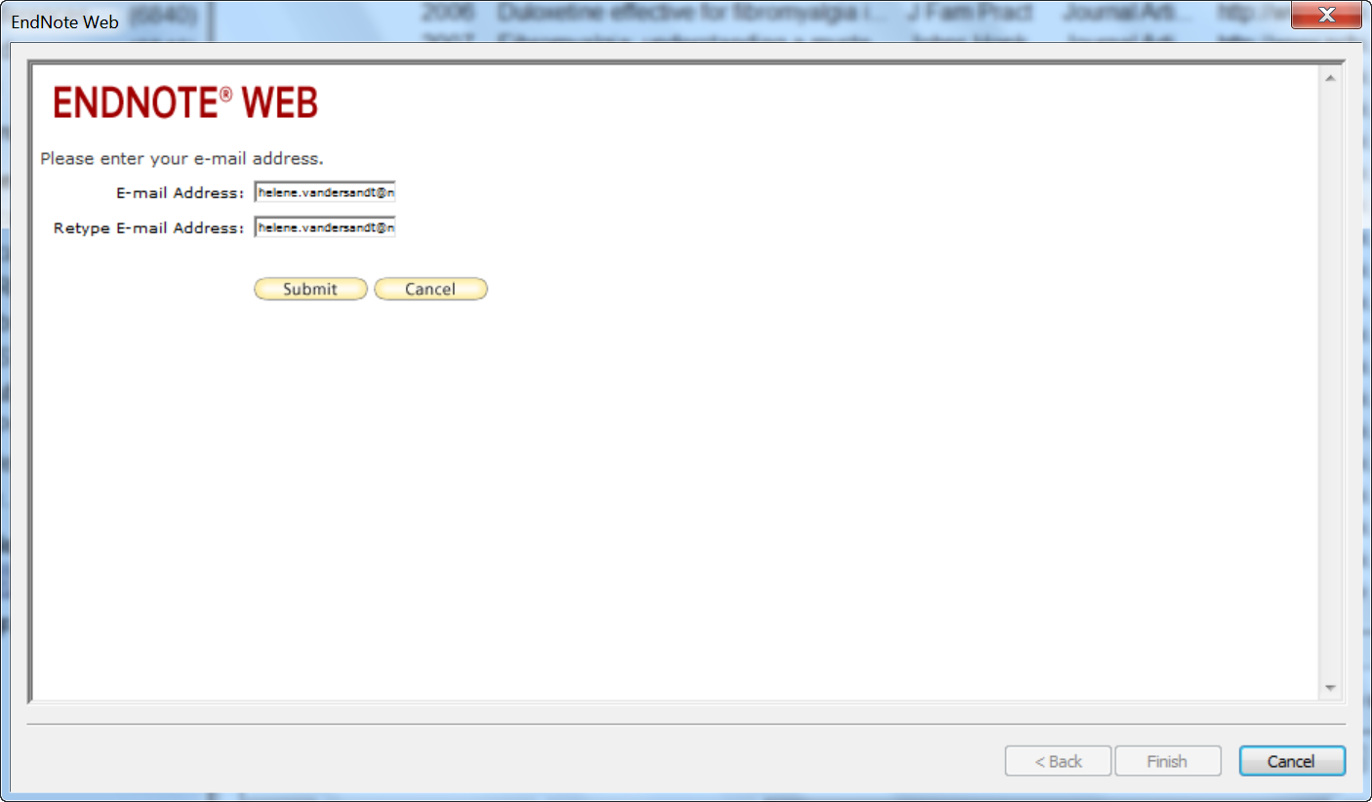

Slide 5
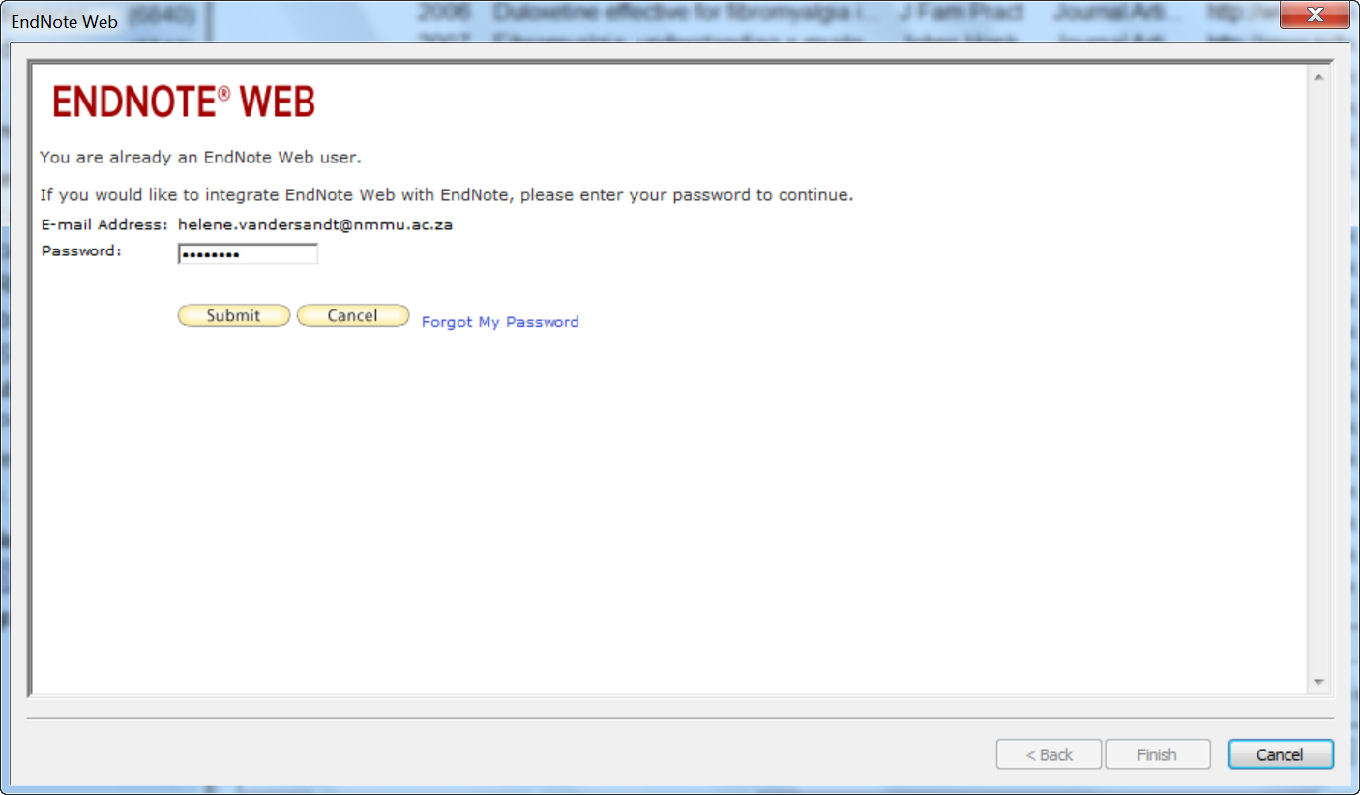

Slide 6
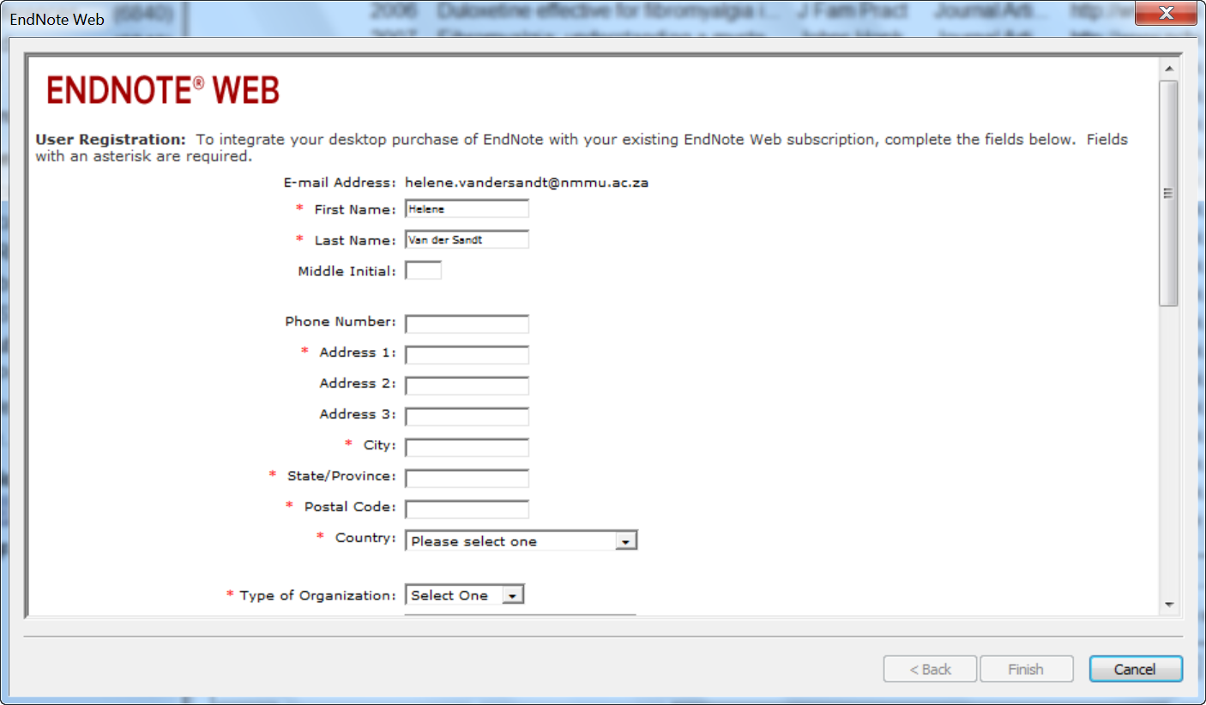

Slide 7
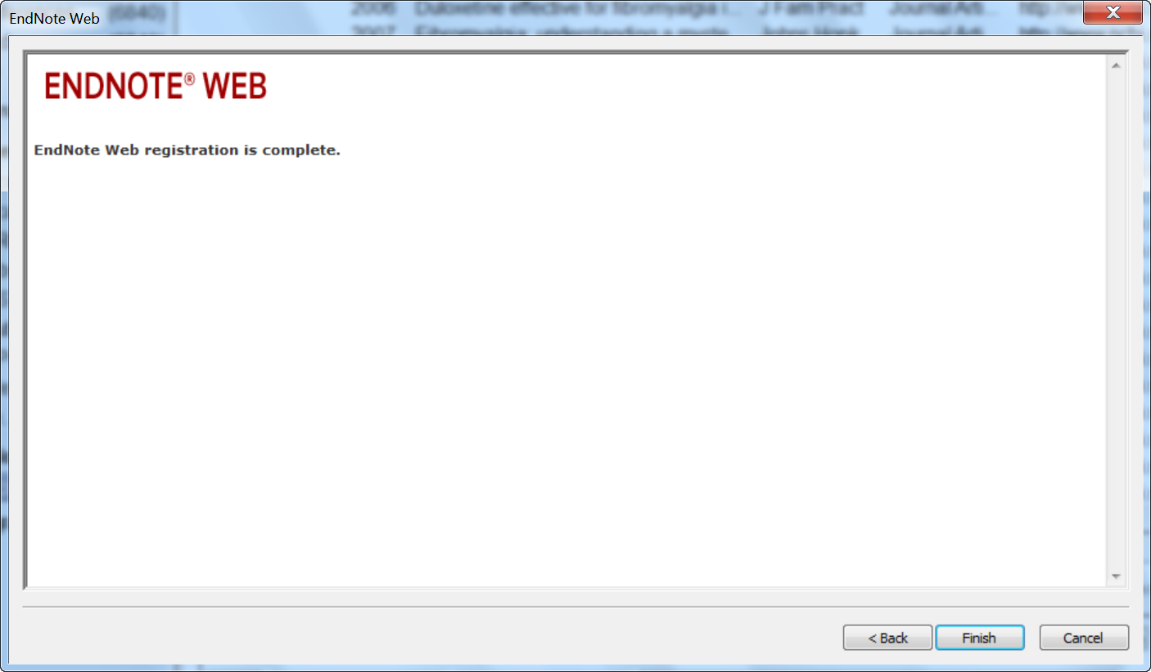
Click on the Finish button to close the window and to return to the configuration page

Slide 8
If your EndNote Web account information is not already in the e-mail address and password field, enter it now
Then click on OK to accept the changes and close the window

Slide 9
TRANSFERRING RECORDS FROM ENDNOTE TO ENDNOTE WEB

Slide 10
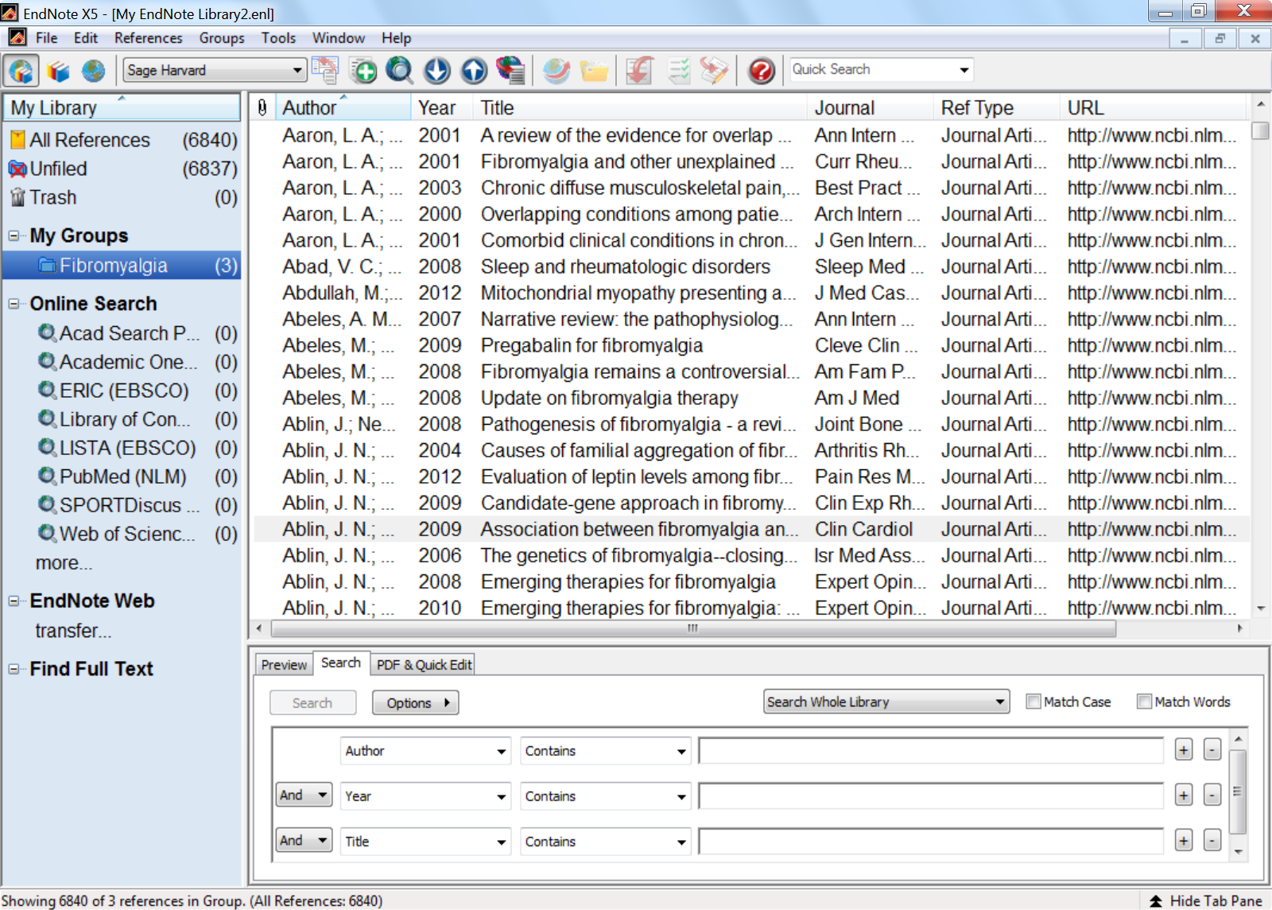

Slide 11
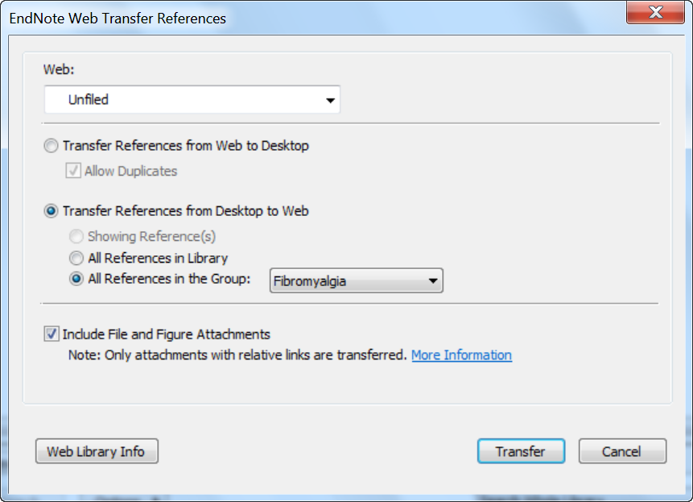
Select the direction of the transfer, from desktop to web or desk to web
Select the references you want to transfer

Slide 12
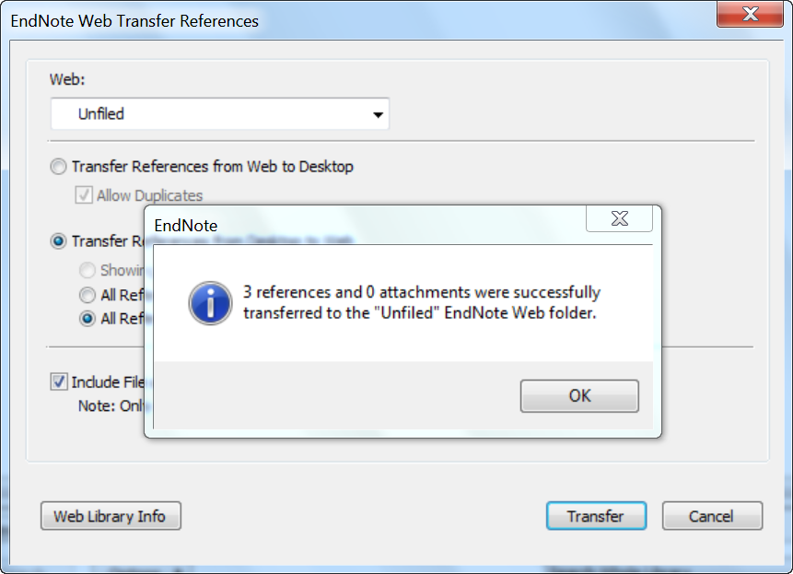

Slide 13
RETRIEVE RECORDS FROM ENDNOTE WEB

Slide 14
OPEN ISI WEB OF KNOWLEDGE (http://library.nmmu.ac.za/Information-resources/Databases)

Slide 15
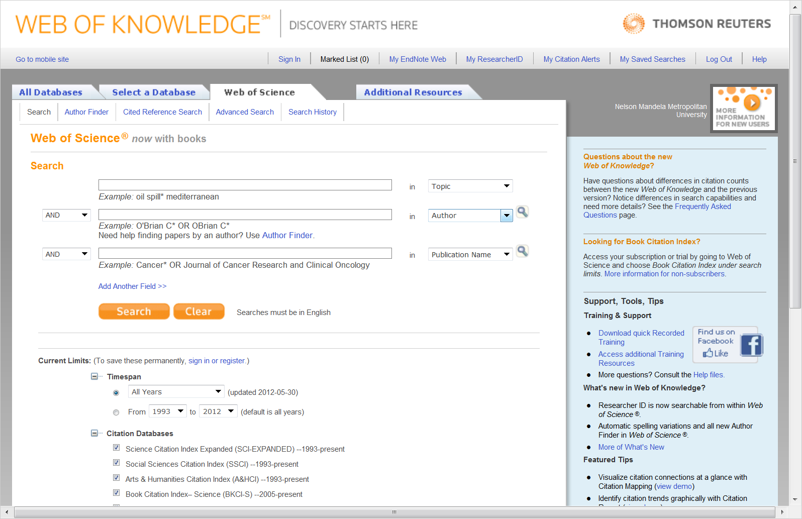

Slide 16
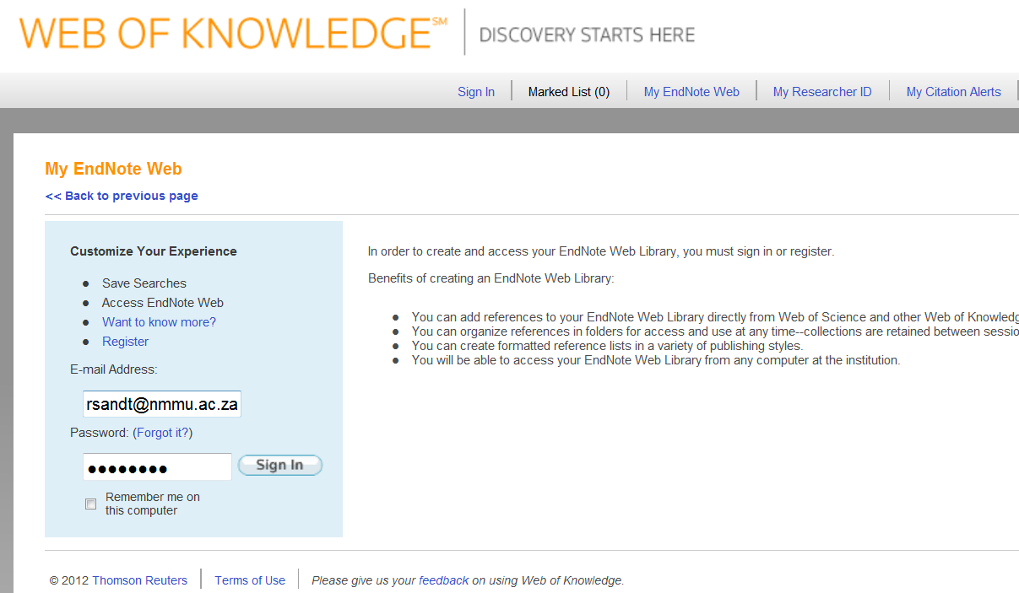

Slide 17
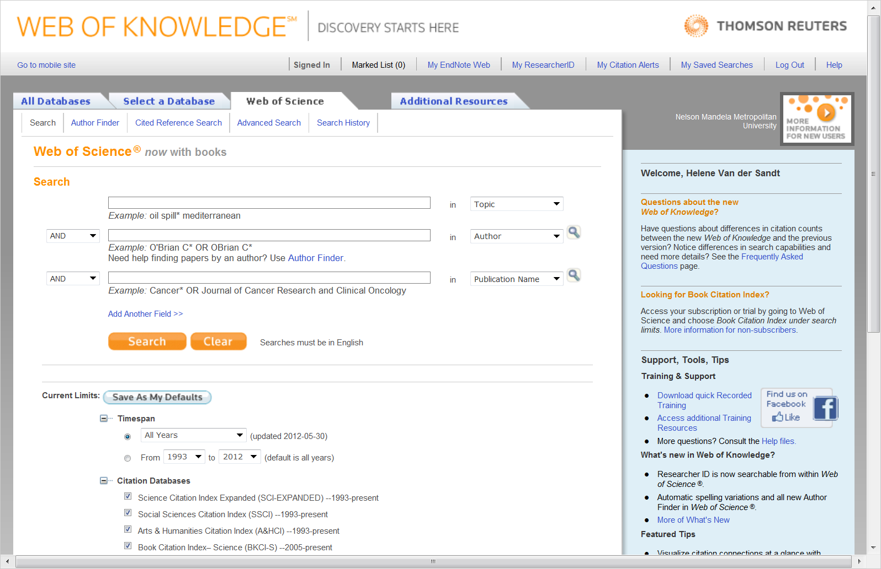

Slide 18
My 3 references transferred from EndNote Desk

Slide 19
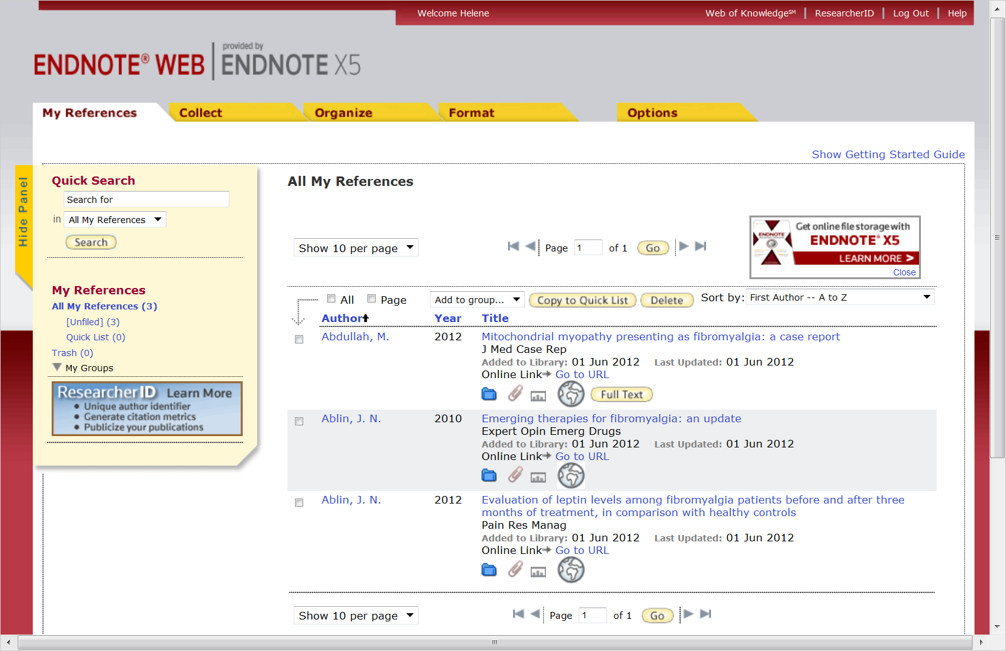
Click on Organize
My 3 references transferred from EndNote Desk

Slide 20
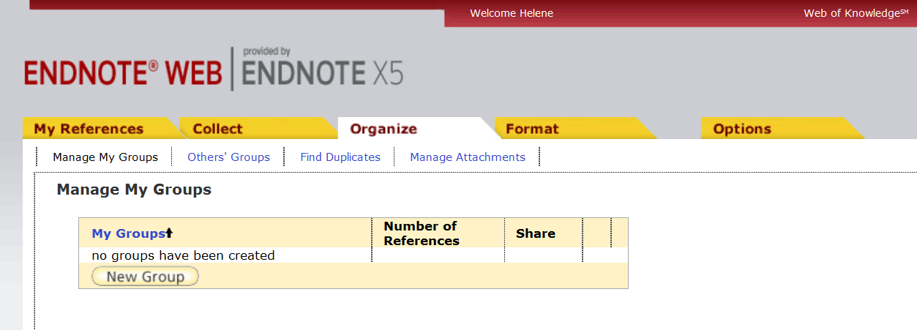
Enter a name for the Group and click OK
Click on New Group

Slide 21
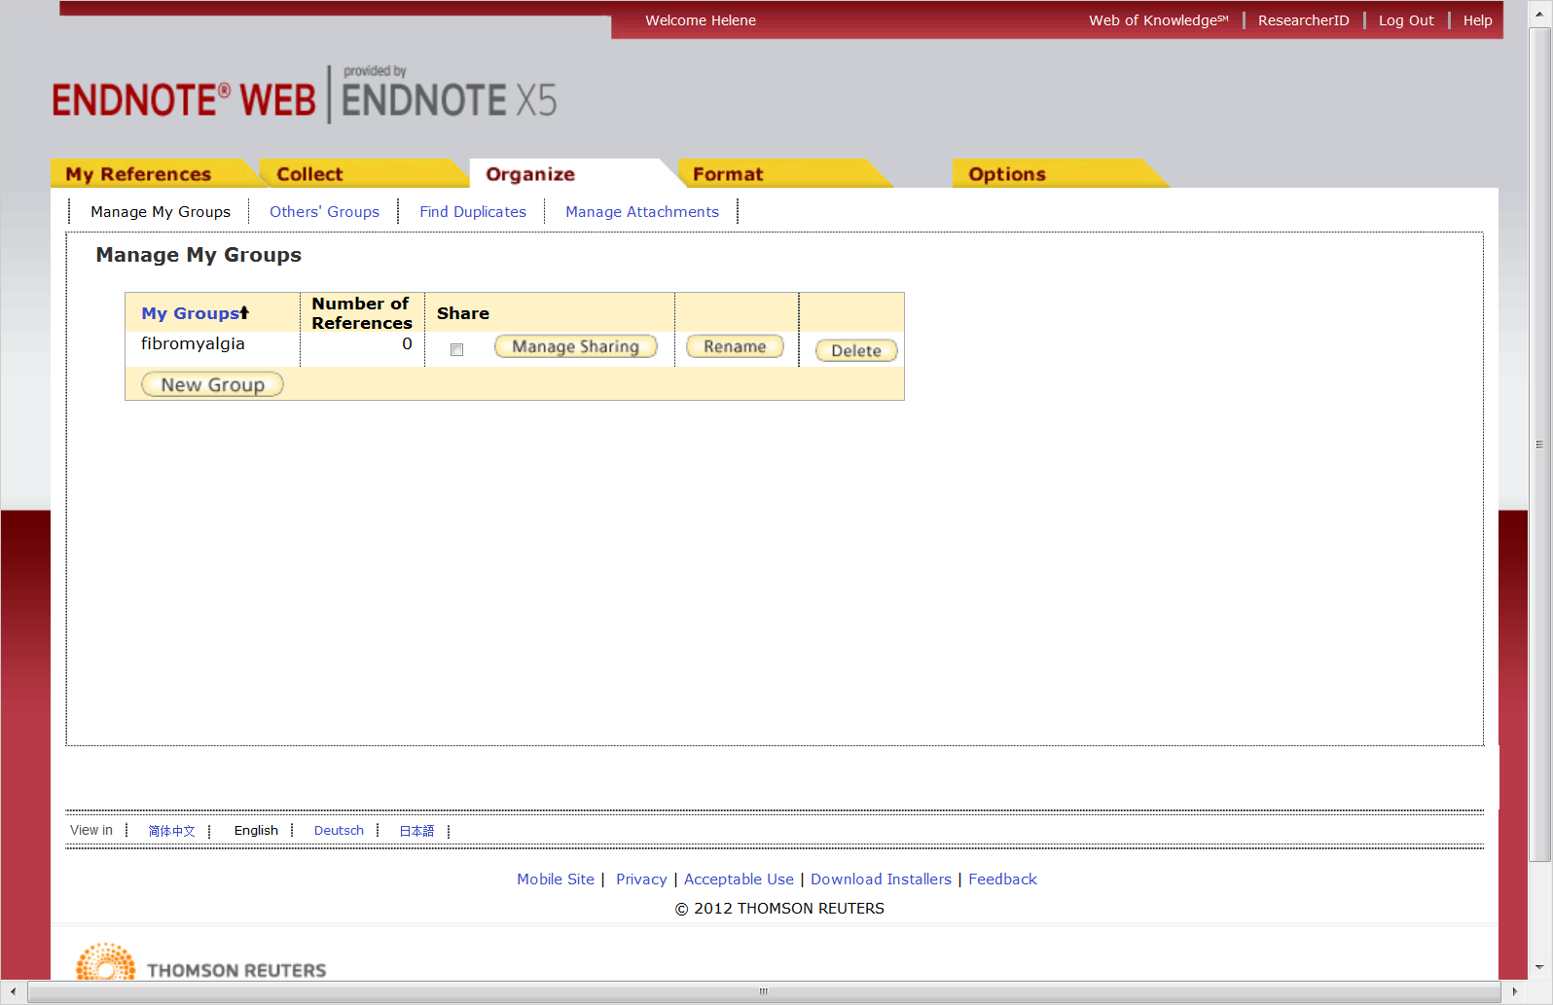

Slide 22
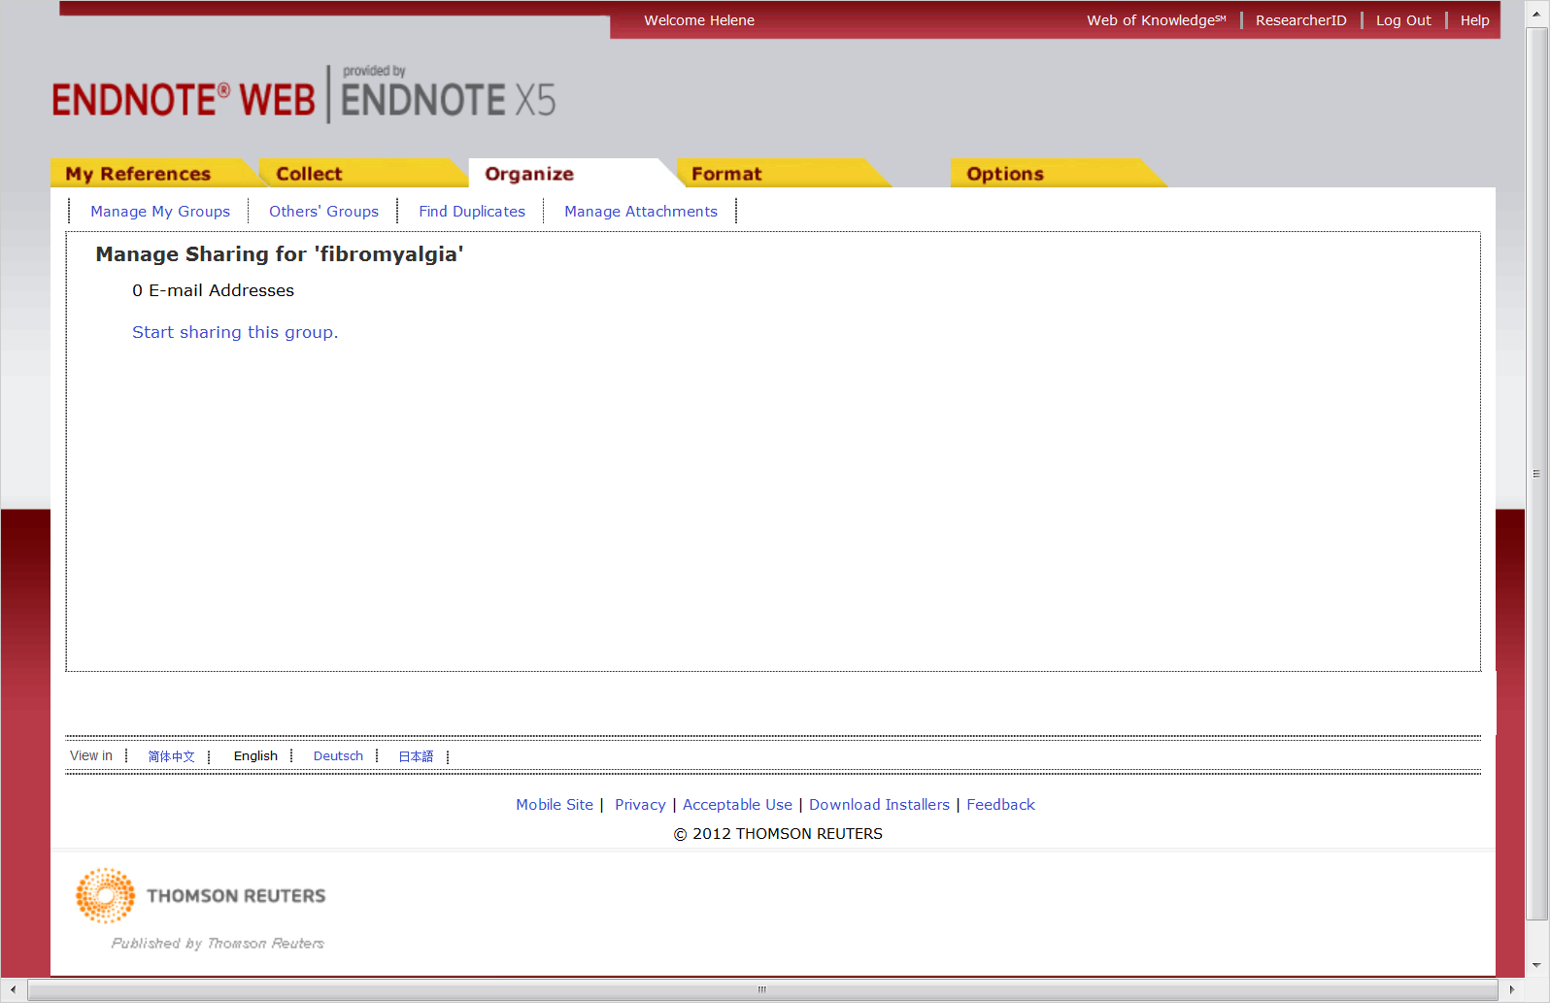

Slide 23
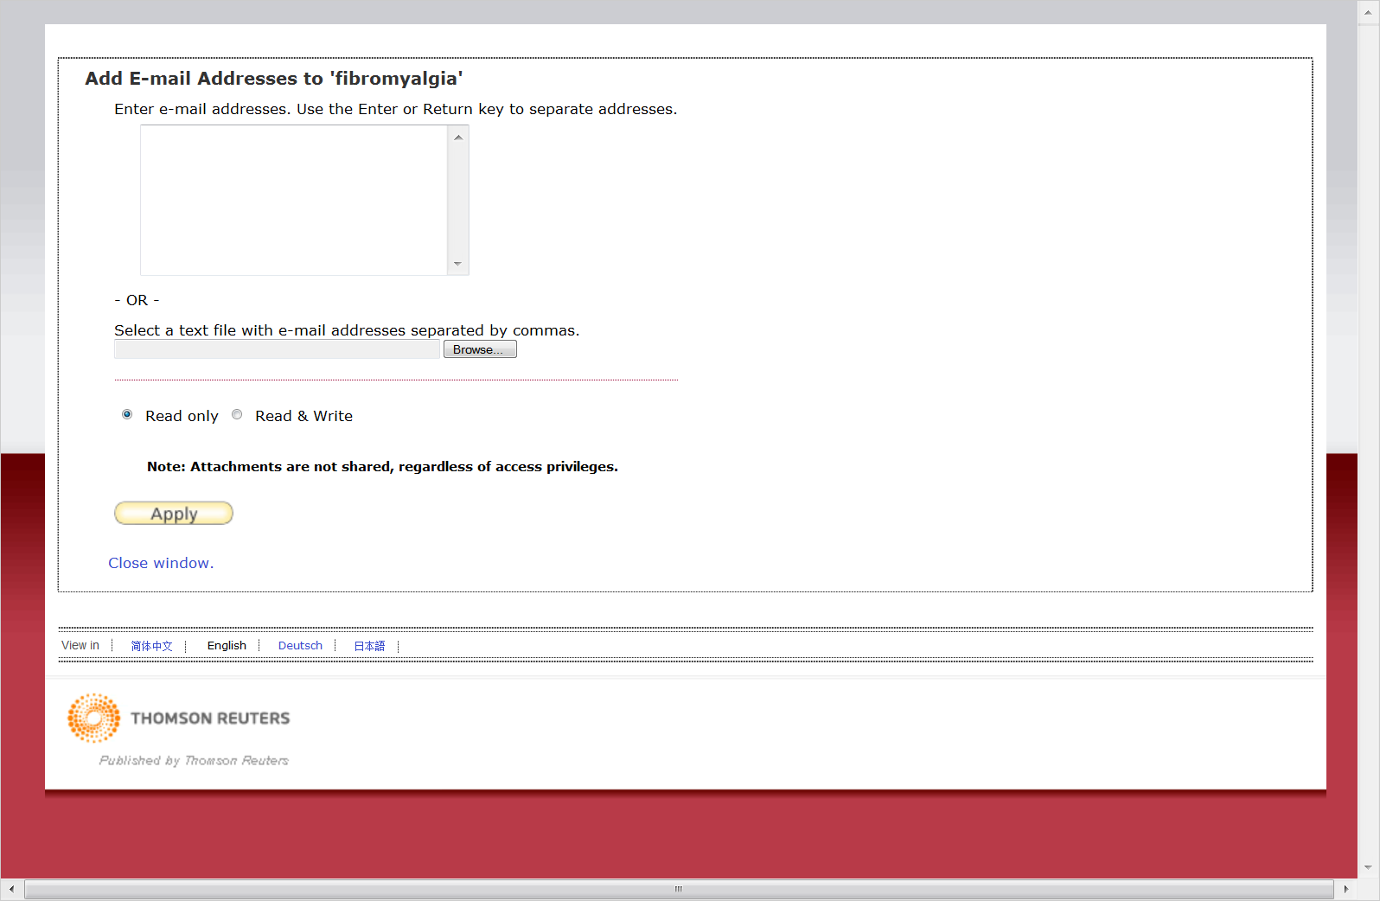
Enter email of person(s) you want to share
Enter their rights

Slide 24
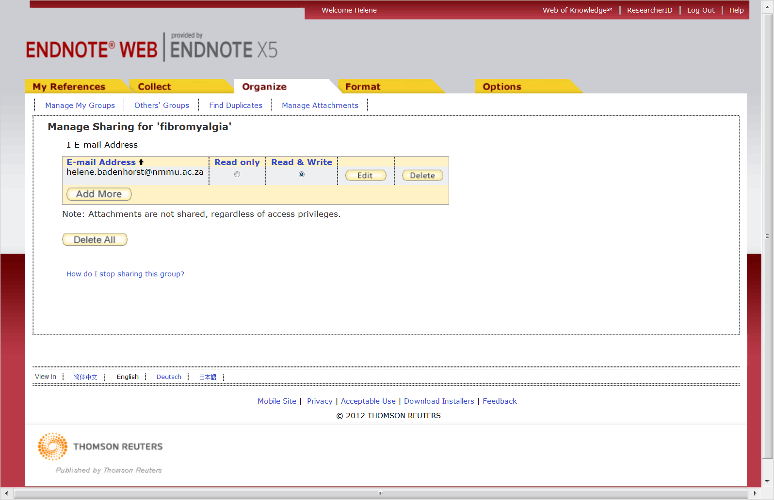
List of person(s) added that can share my Fibromyalgia folder

