Slide 2
What Should I Do if My Style Is Not Included?

Slide 3
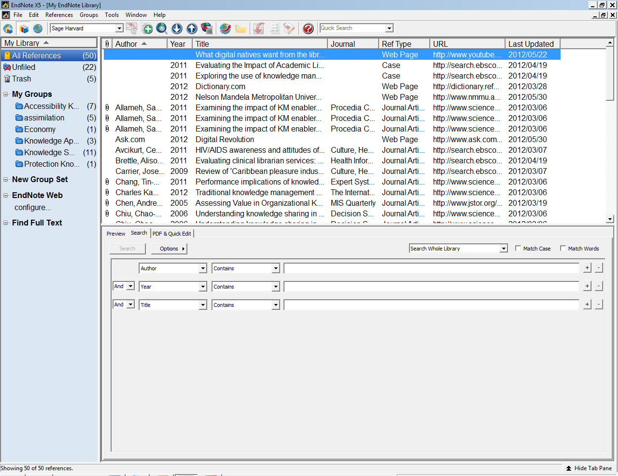
From the Edit menu, select Output Styles, and then select Open Style Manager.
Click on Edit and then Select Output Styles and then Style Manager

Slide 4
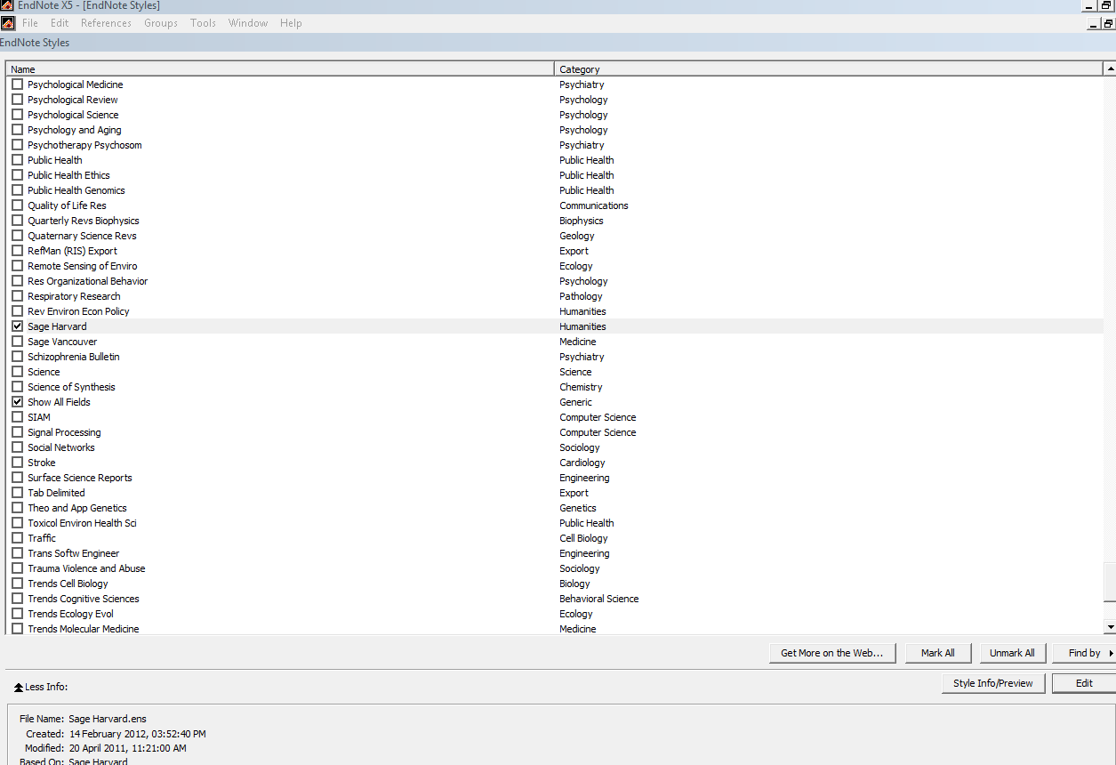
In the Style Manager, change the setting in the information panel from Style Info to Style Preview. The preview of the selected style should now be displayed.
Scroll through the list of available styles to see if you can find one that is similar to what you need.

Slide 5
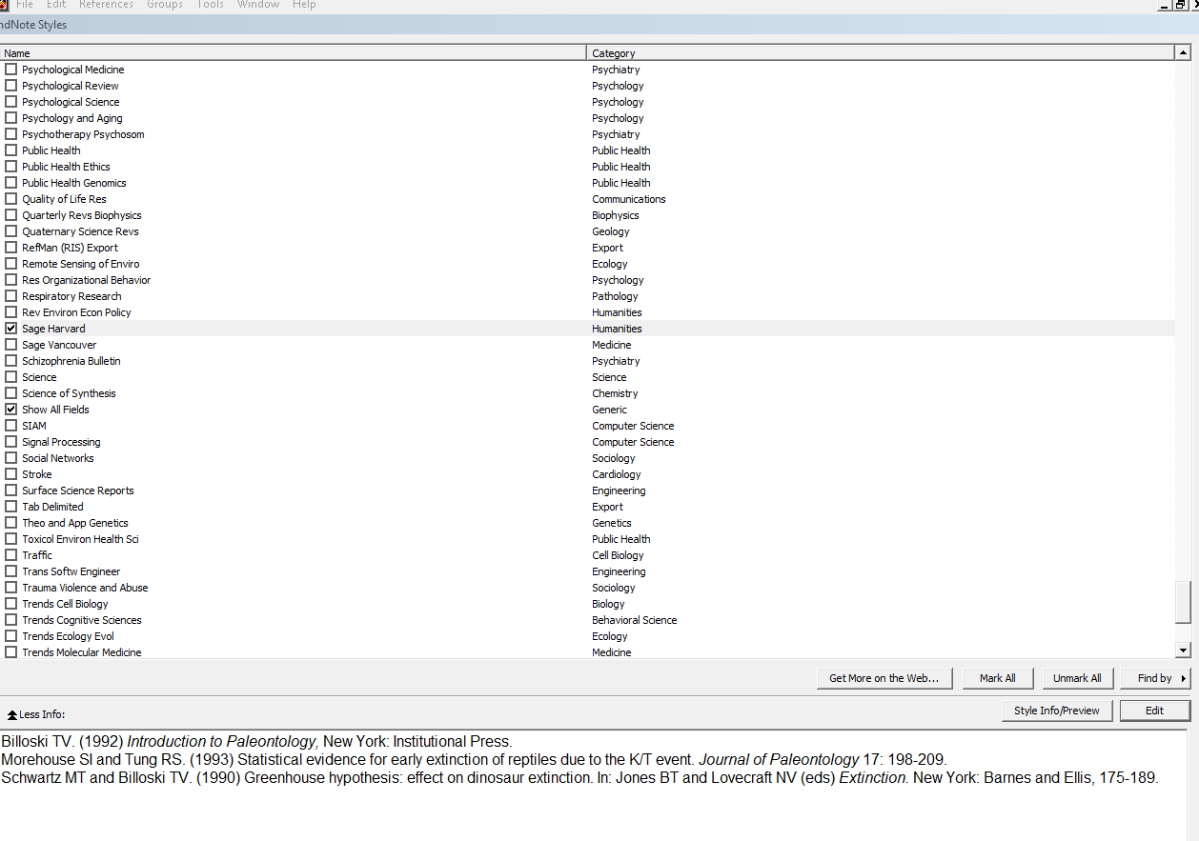
Once you have found a similar style, select it, and click the Edit button. The Style window opens.

Slide 6
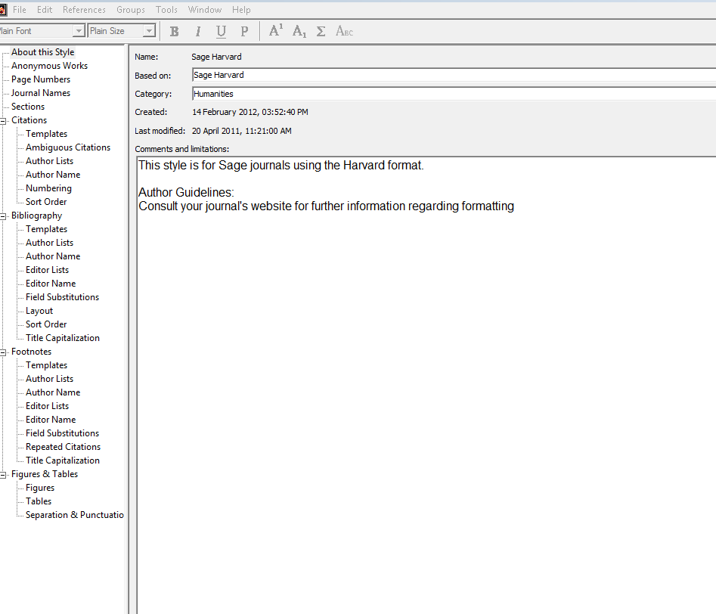

Slide 7
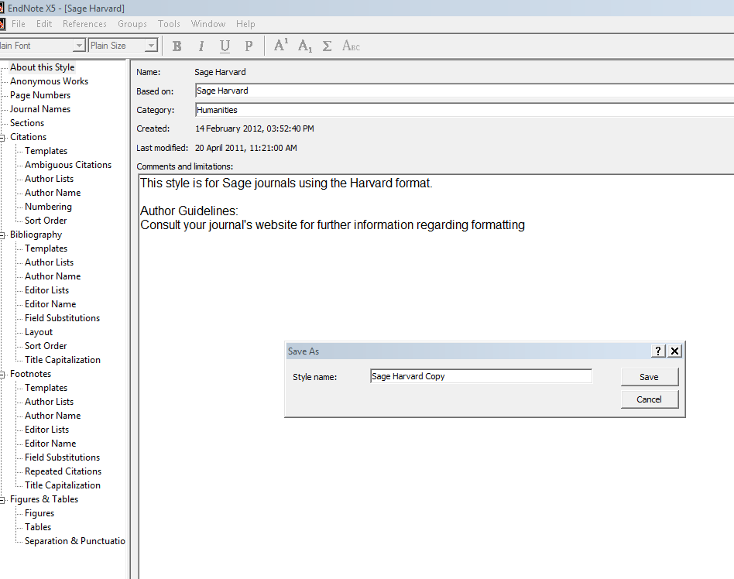
1 Select File Menu
Save style under your reference style name
Notes:
From the File menu, sSelect Save, give this copy of the style a new name that corresponds to the name of the journal you want to use it for, and click Save. This will also keep the original style unchanged, in the event that you need to use it later.

Slide 8
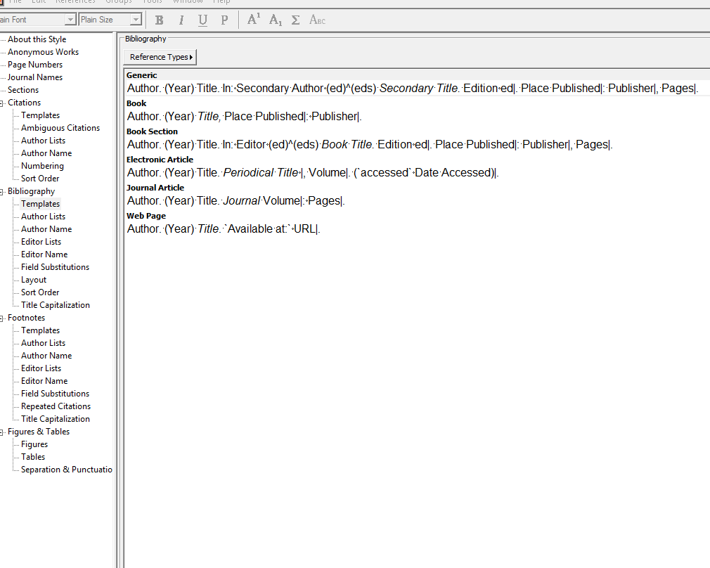
The new Style window remains open for you to edit it as you need
Notes:
. For more details about editing parts of a style, read Modifying Style Templates and Additional Style Formatting Options.

