Slide 1
Adding PDF documents/Folders to Endnote
Deidre Gerber

Slide 2
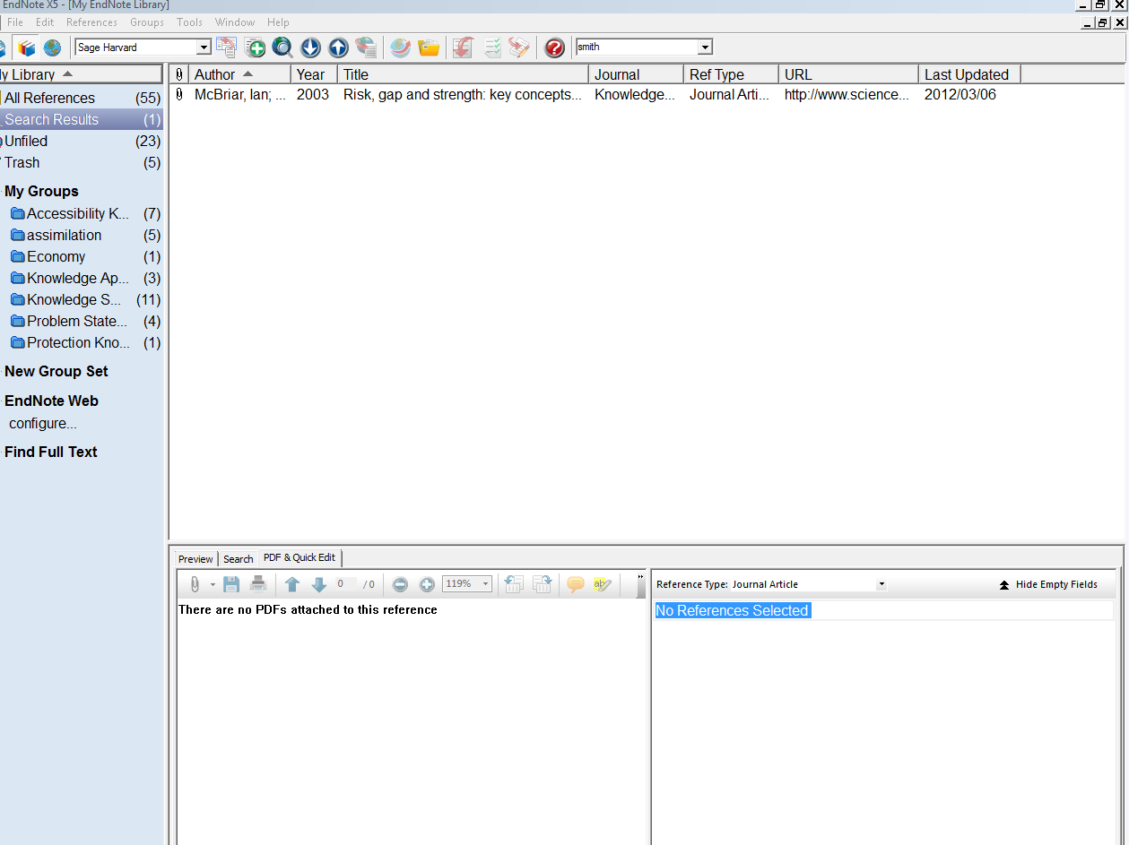
Open Endnote – Blank page

Slide 3
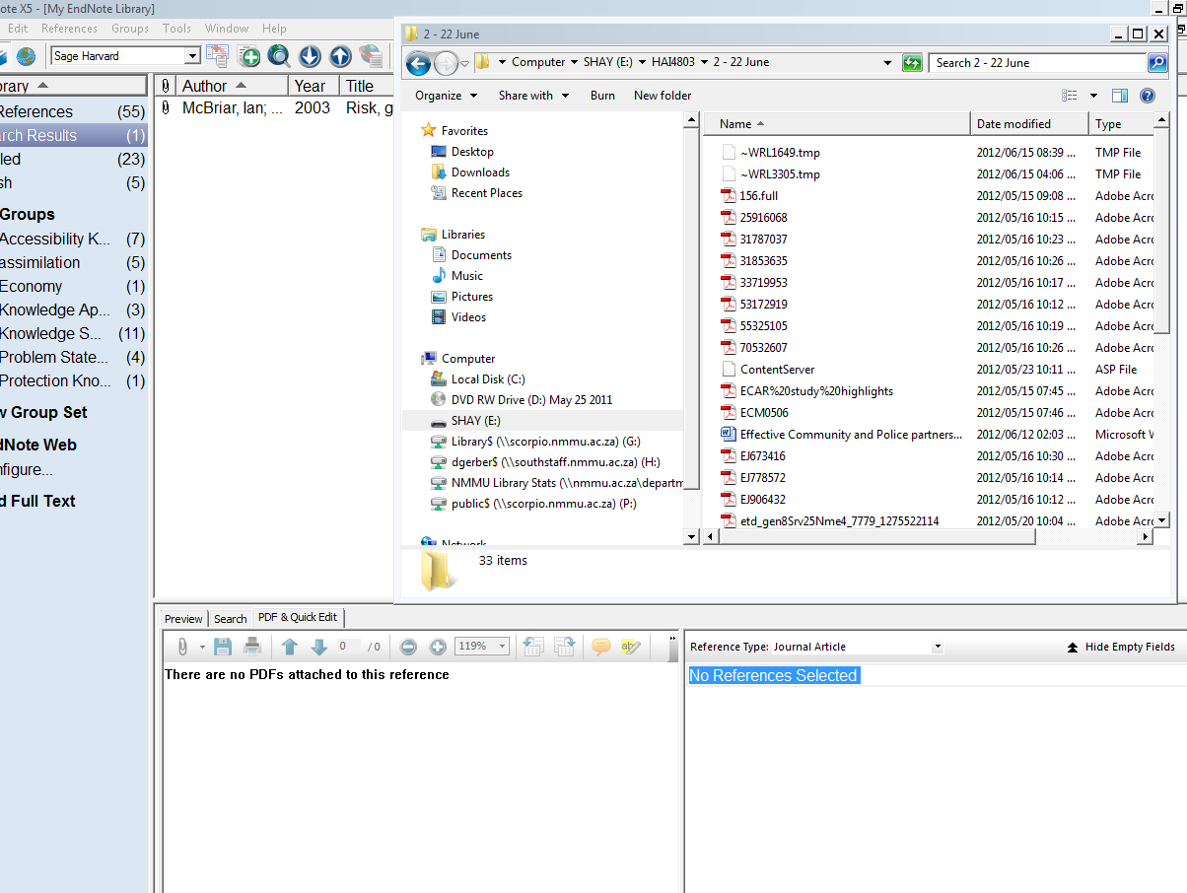
Open PDF document file
Drag and drop PDF file into left block

Slide 4
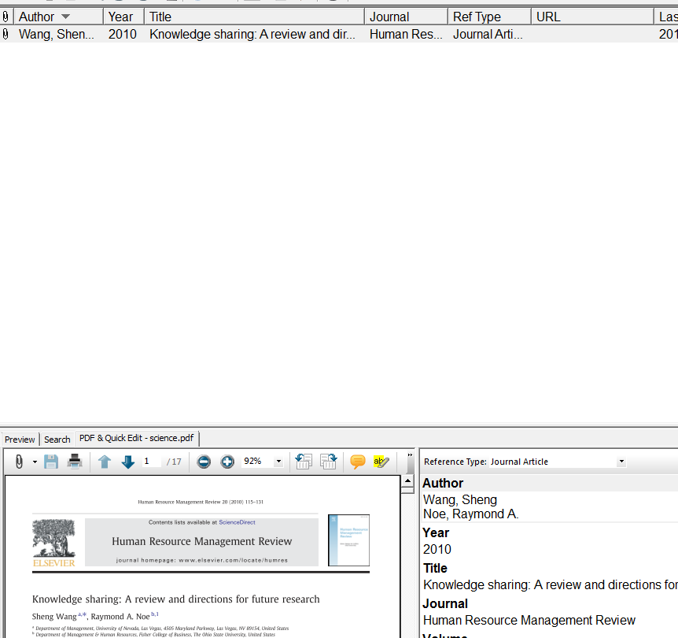
Results
References will automatically be added in the right hand corner

Slide 5
Importing PDF Files into EndNote from PC/laptop

Slide 6
Importing Folder with PDF’s or single File
Choose File for single PDF or Folder with several PDF’s

Slide 7
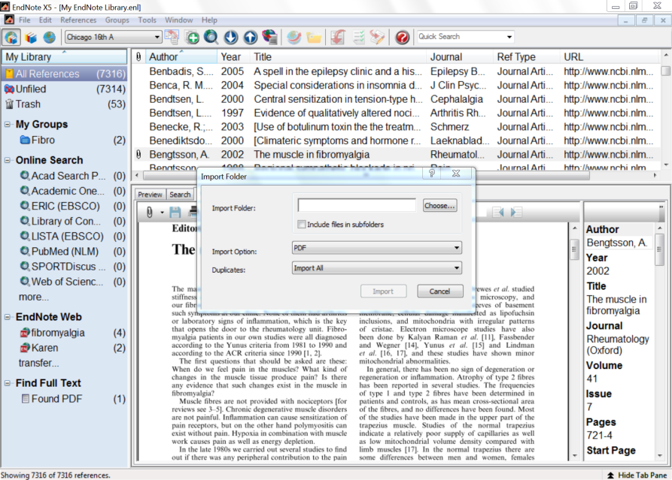
Click here
Make sure “PDF” is selected.

Slide 8
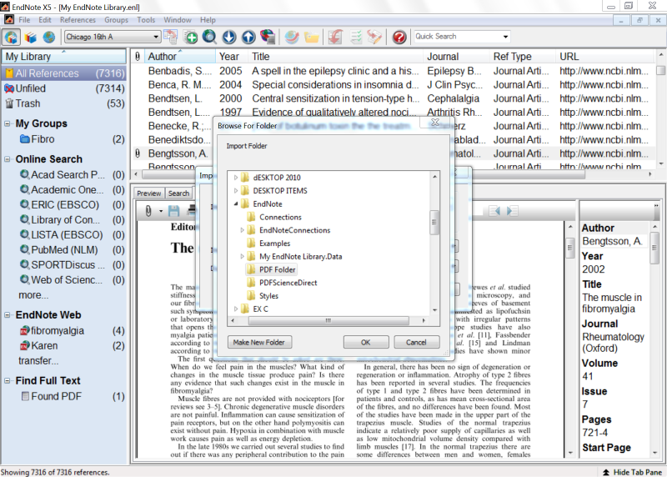
Find relevant PDF Folder on PC/laptop

Slide 10
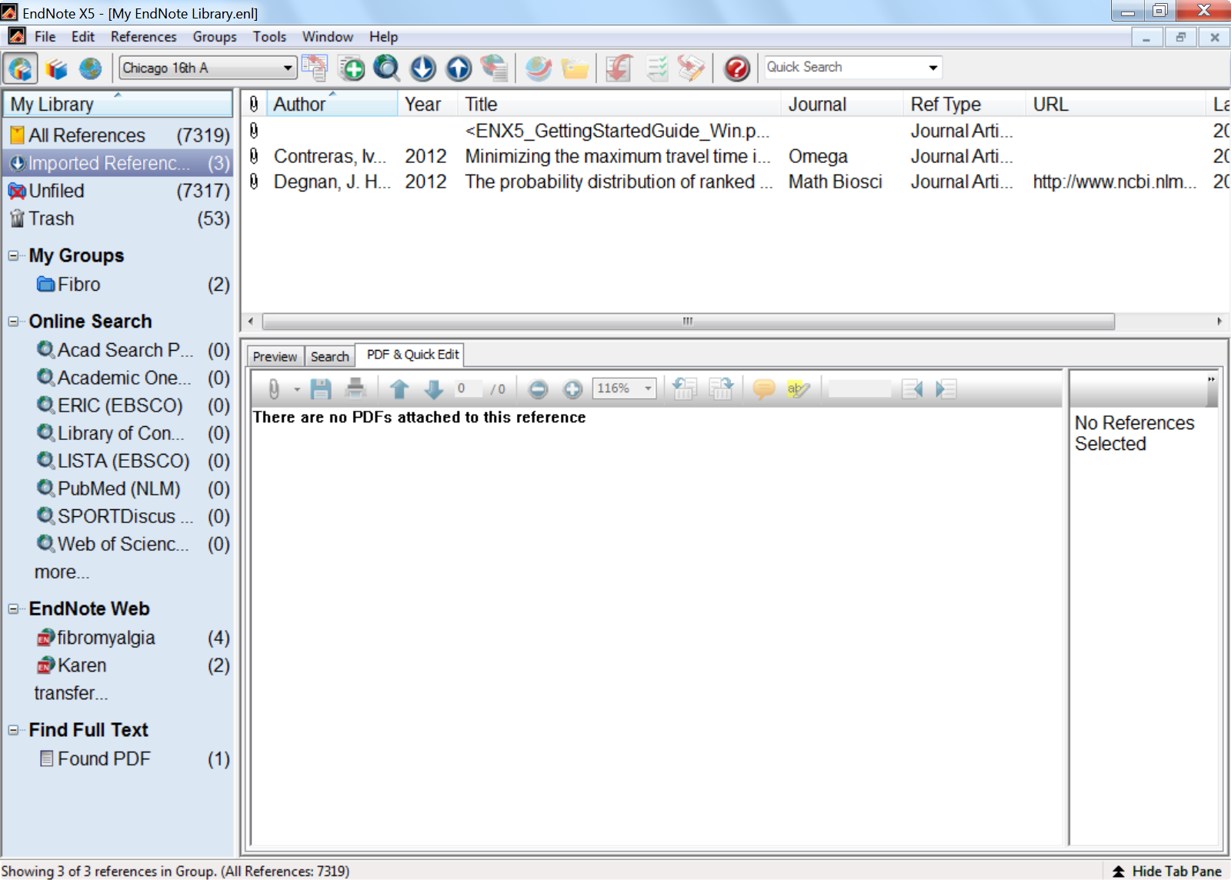
Imported PDF’s
With EndNote X5 you can use the Import feature to import a group of pdfs and generate the metadata for the references in EndNote directly.
Be aware that EndNote is not able to generate metadata from just ANY pdf, but it seems to work for most recently created pdfs. The pdf's must have a DOI (unique number assigned to journal articles), before a reference will be automatically generated.

