Slide 1
Getting started with ENDNOTE Compiled by Helene van der Sandt

Slide 2
ENTERING A REFERENCE IN ENDNOTE

Slide 3
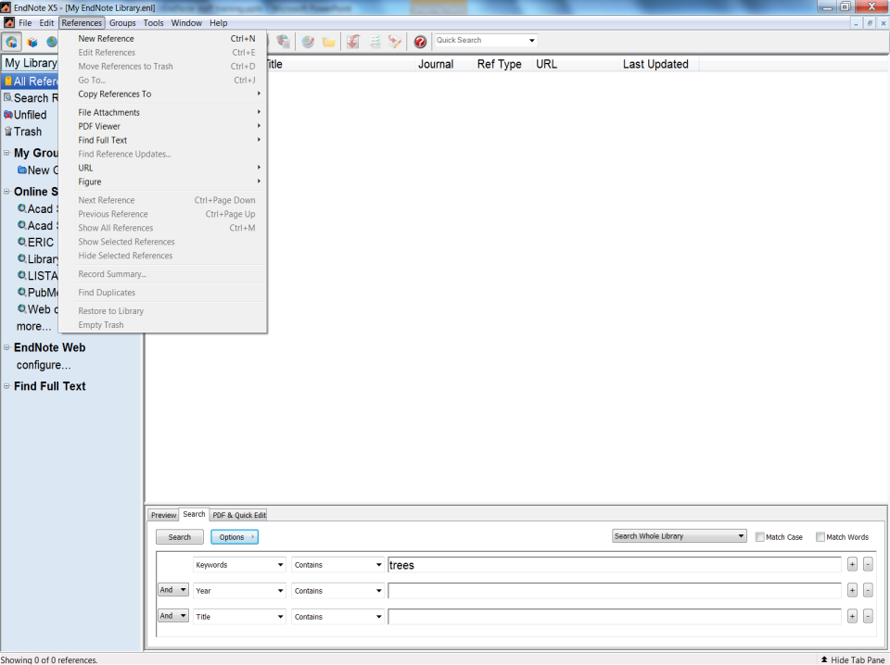
Click on the References tab, and then from the References
menu, select New Reference to display an empty Reference
window.

Slide 4
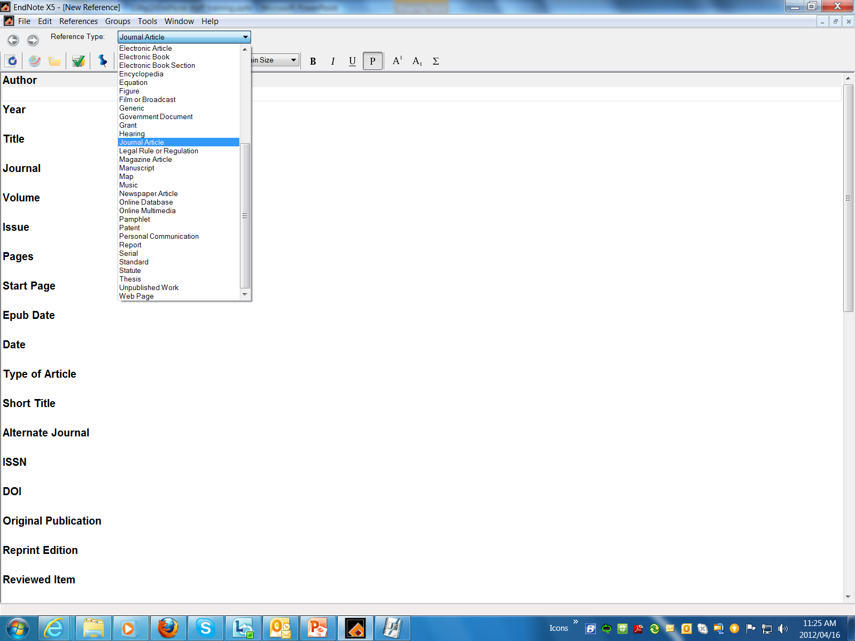
ENTERING A REFERENCE DIRECTLY
New references appear as Journal Article (unless you
change the default setting).
Select the Book reference type from the Reference Type menu.

Slide 5
Notice that the Field list changes to reflect the type of
bibliographic information you would record for a book.

Slide 6
Enter the author’s name, but with the surname first. Click “Enter”
When entering corporate authors, put a comma after the name:
Apple Computer Inc.,
South Africa. Dept. of Housing,
This ensures that the entire name is treated as a first name, so no name manipulation will be applied.
If your corporate author name includes a comma in the name itself, use two commas in place of the first comma:
Press Tab to accept the author name and move to the Year.

Slide 7
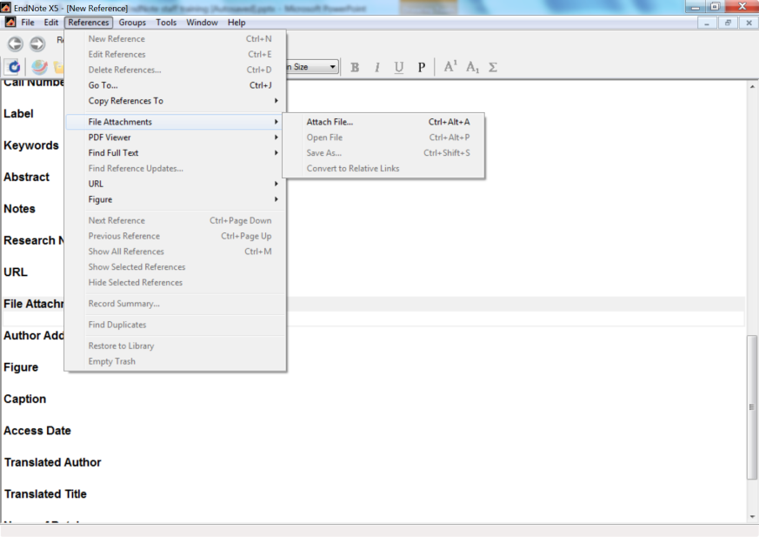
To add a PDF file to the reference
From Reference Menu, select File Attachments and then attach File
Scroll to File Attachment field

Slide 8
Save your work and click here to close the Reference Window.
Continue entering the reference. No extra punctuation (such as parentheses around the year) or text styles (such as bold or italic) are entered into the reference.
EndNote adds the necessary punctuation and text
style changes to the references when it creates a
bibliography.

Slide 9
EXPORTING DIRECTLY FROM ONLINE DATABASES TO ENDNOTE
Always use the web browser, Internet Explorer.

Slide 10
EXPORT FROM EBSCOHOST TO ENDNOTE

Slide 11
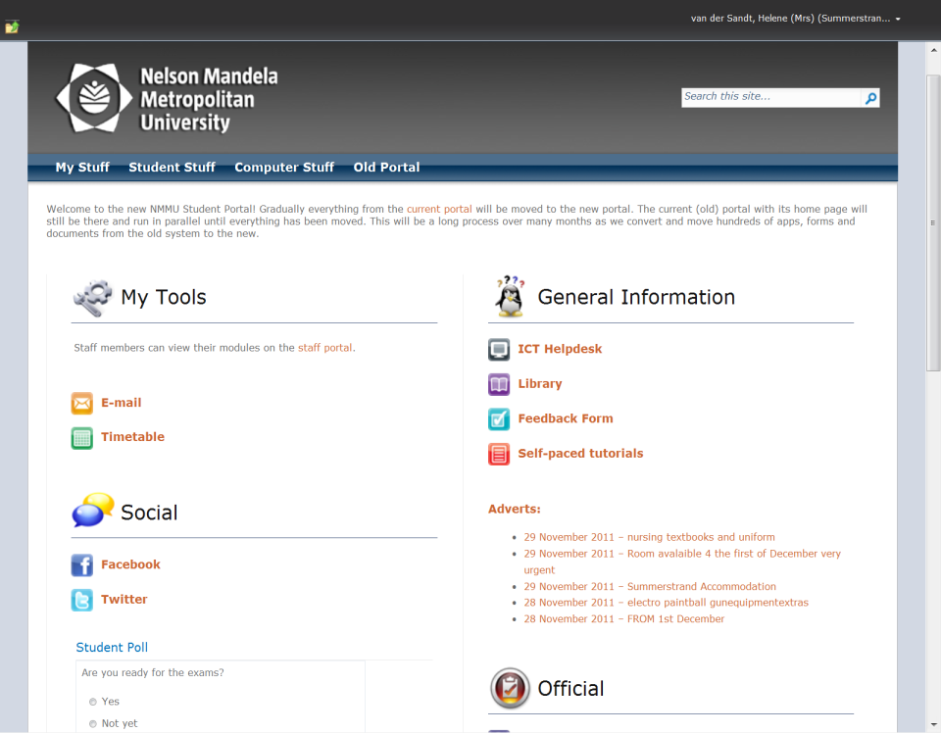
VIA STUDENT PORTAL
Click on this icon to go to Library web site

Slide 12
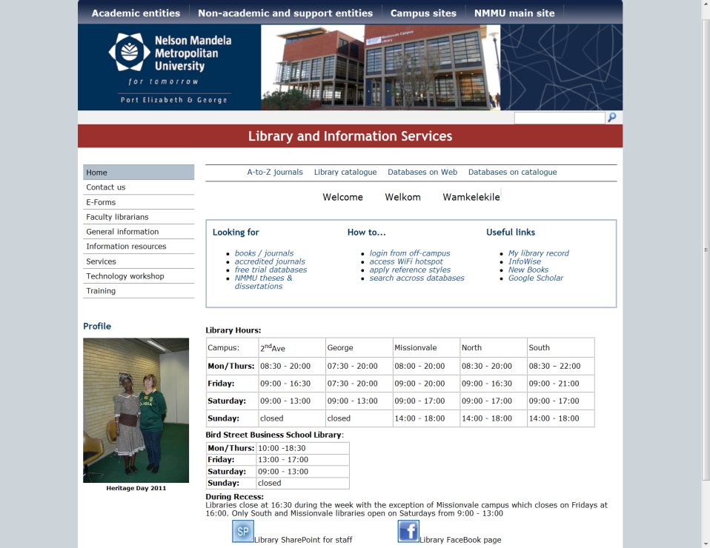
LIBRARY WEB PAGE

Slide 13
Off campus access: www.nmmu.ac.za/library
Notes:
Refer to to the relevant page in the Library Guide with the QR Tag.

Slide 14
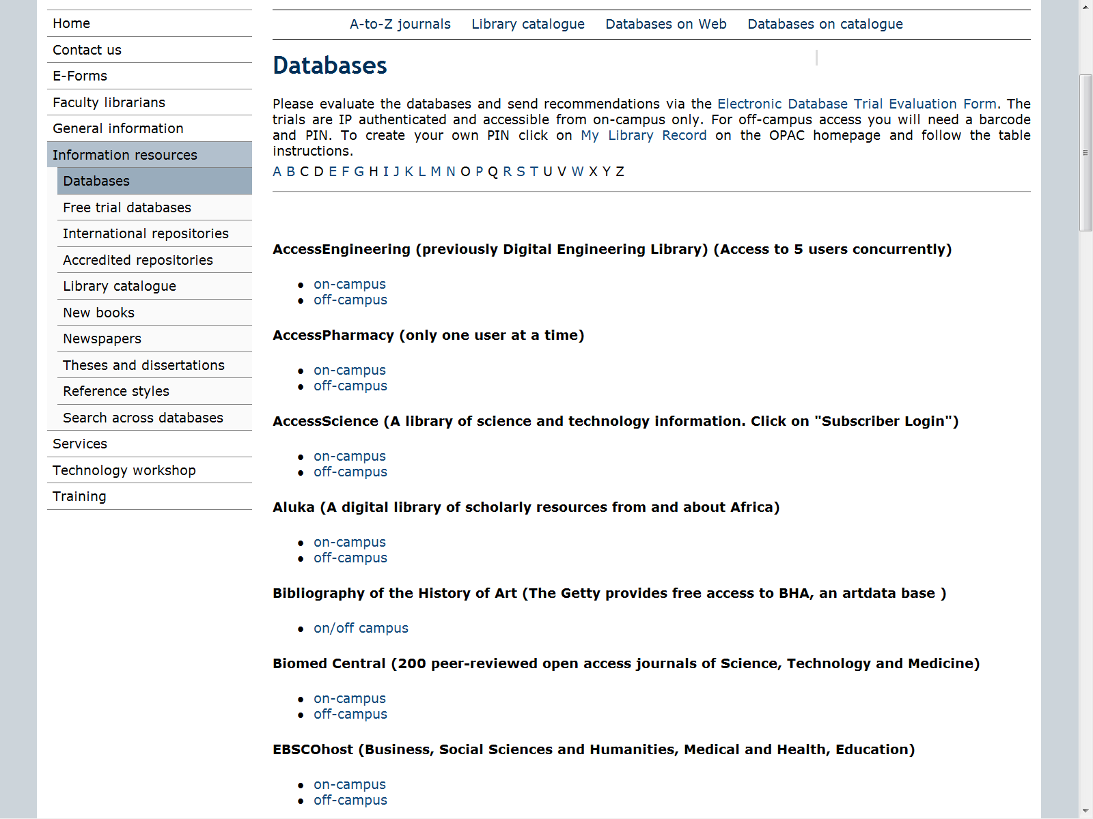
Database Page

Slide 15
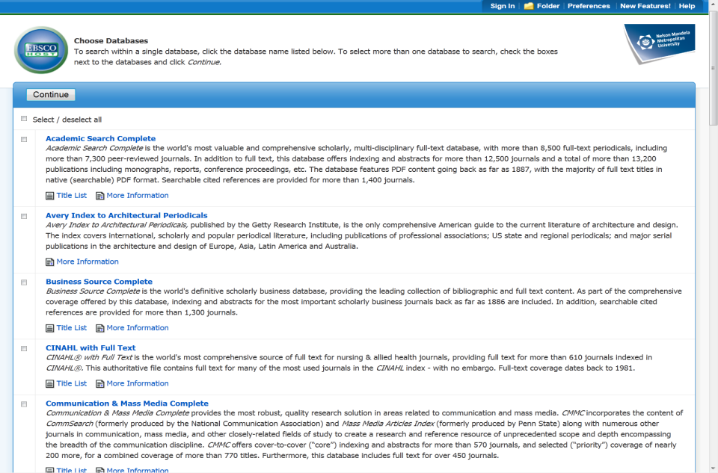
CHOOSING DATABASES
Always select these multi-disciplinary databases:
Academic Search Complete
E-Journals
MasterFILE Complete
Also select other databases applicable to your topic
Click Continue

Slide 16
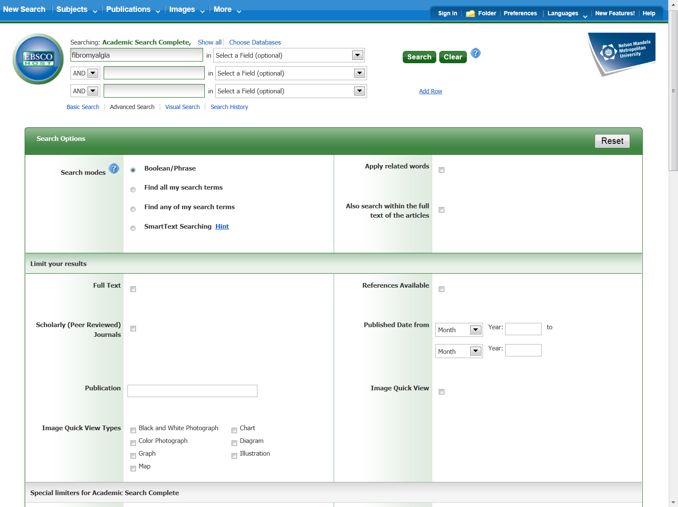
SEARCHING EBSCOHOST
Type keywords in search boxes.
You can also select certain fields.
You can also limit your search, e.g. full text, date, peer reviewed

Slide 17
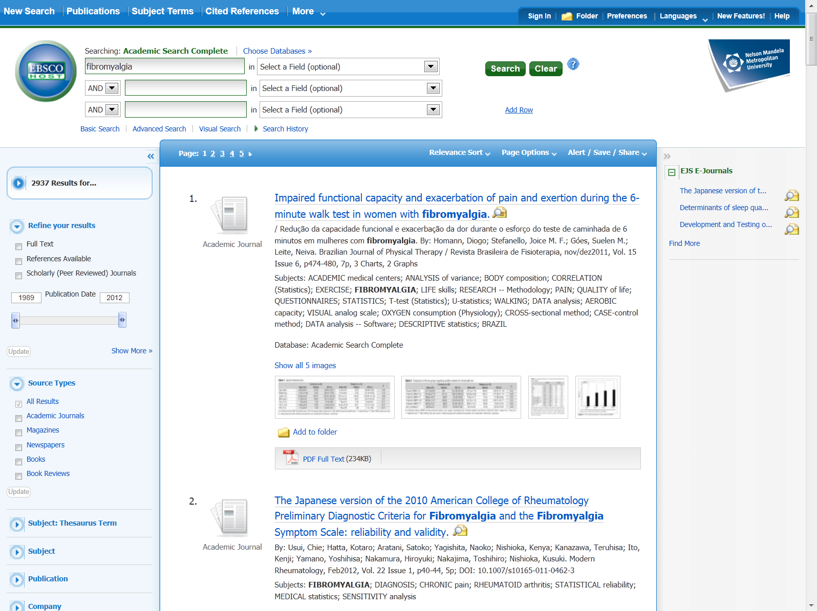
EBSCOHOST SEARCH RESULTS PAGE
Click on Folder to view selected articles
Add relevant articles to Folder

Slide 18
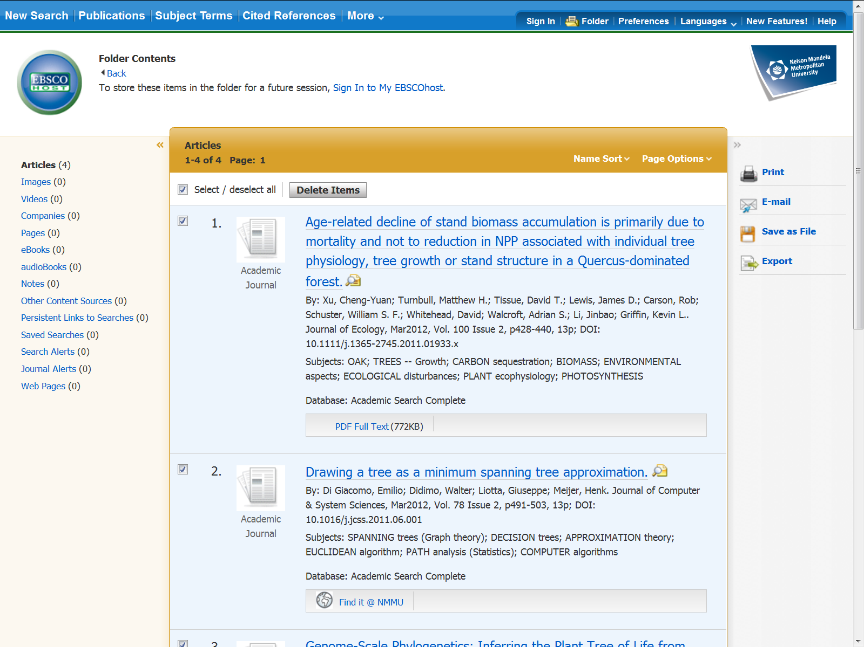
EBSCOHOST FOLDER PAGE

Slide 19
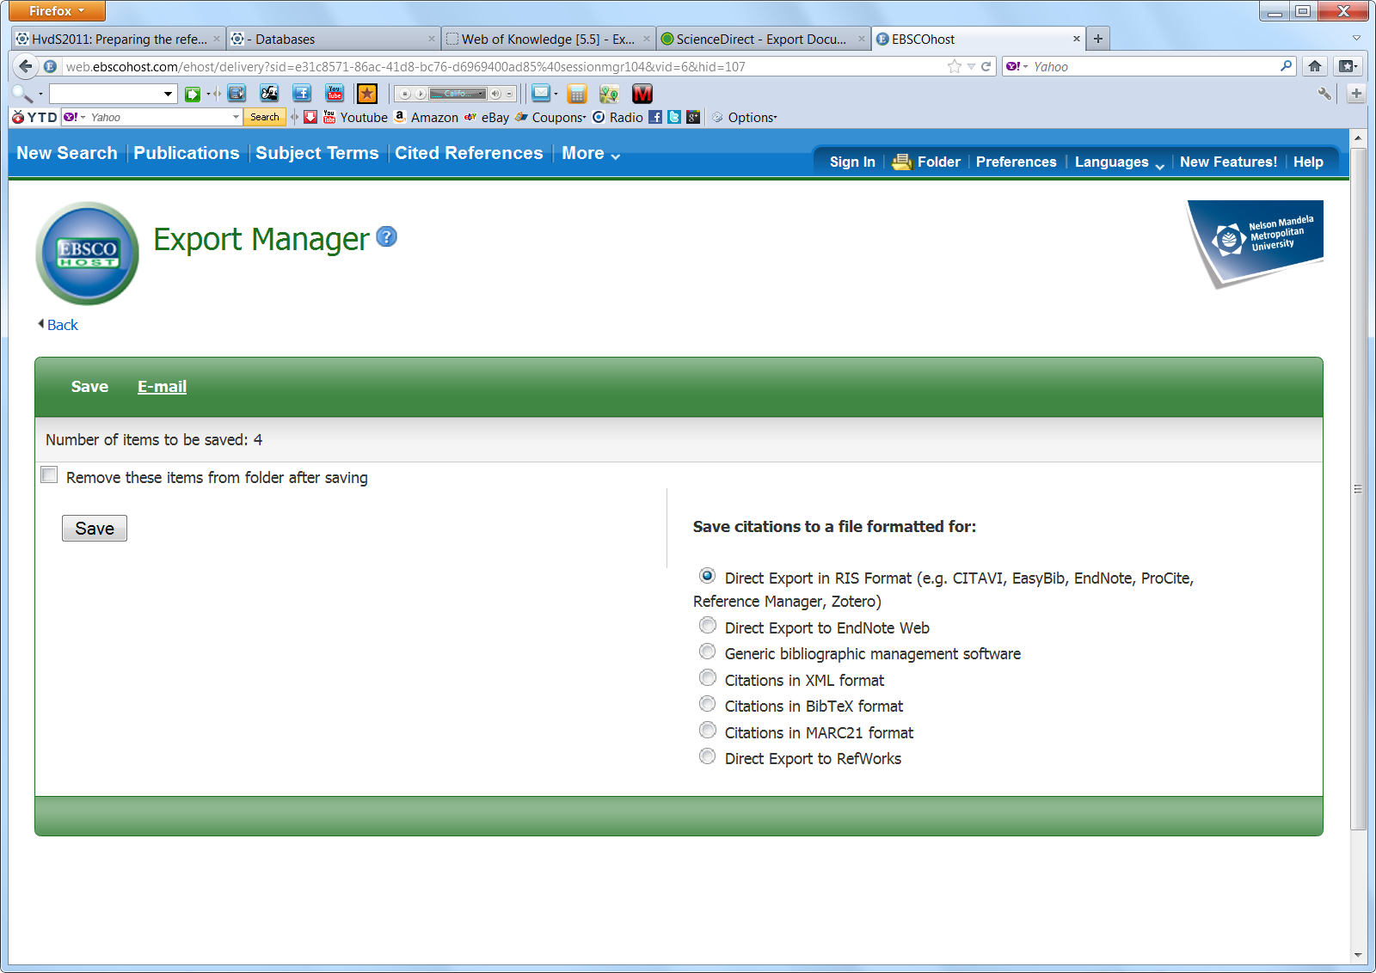

Slide 20
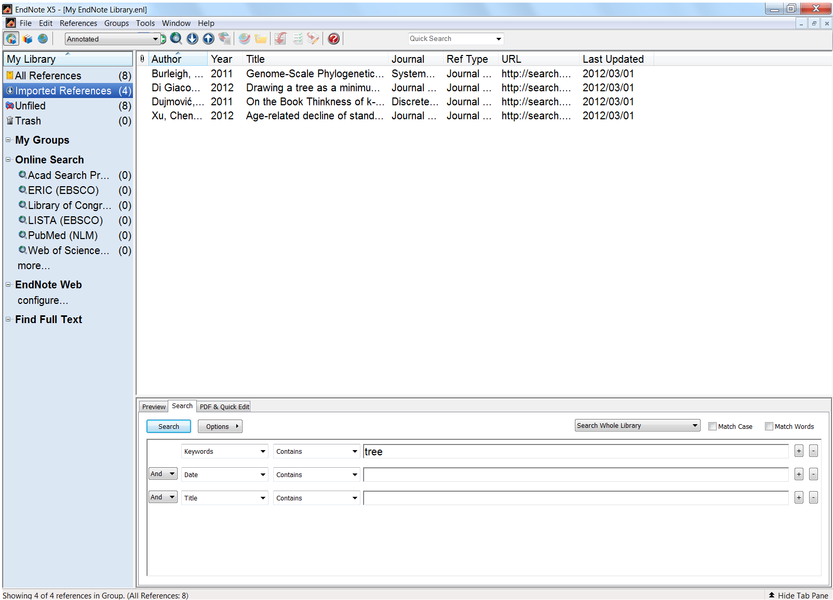
Imported references from EbscoHost

Slide 21
EXPORTING FROM GOOGLE SCHOLAR TO ENDNOTE

Slide 22
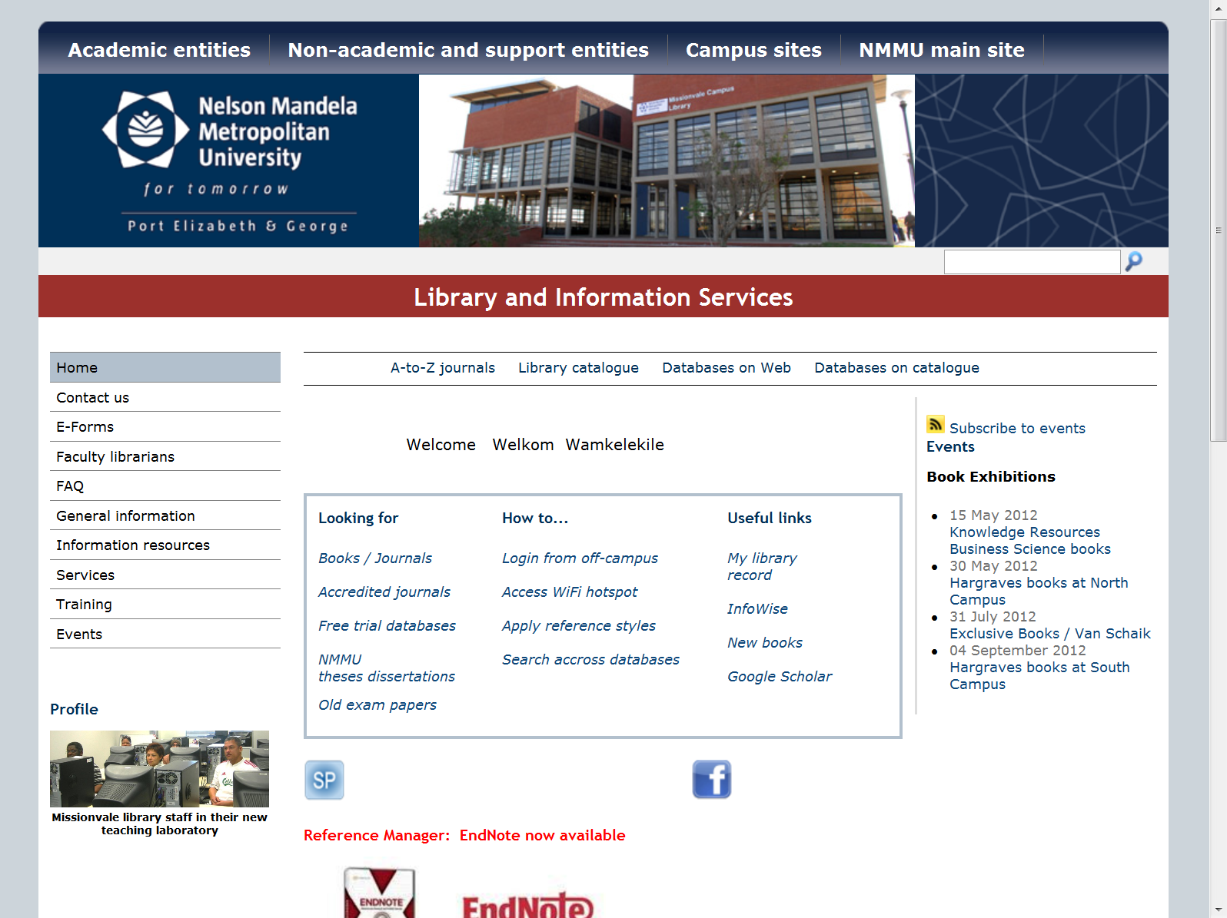
ACCESS TO GOOGLE SCHOLAR TO LIBRARY PAGE

Slide 23
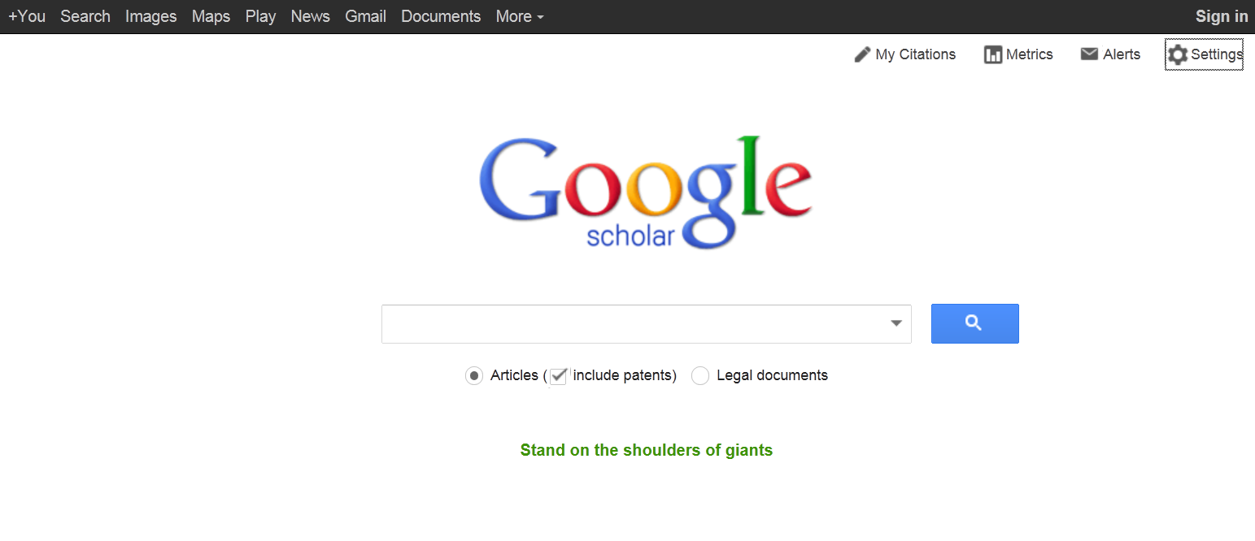
CHANGE SETTINGS

Slide 24
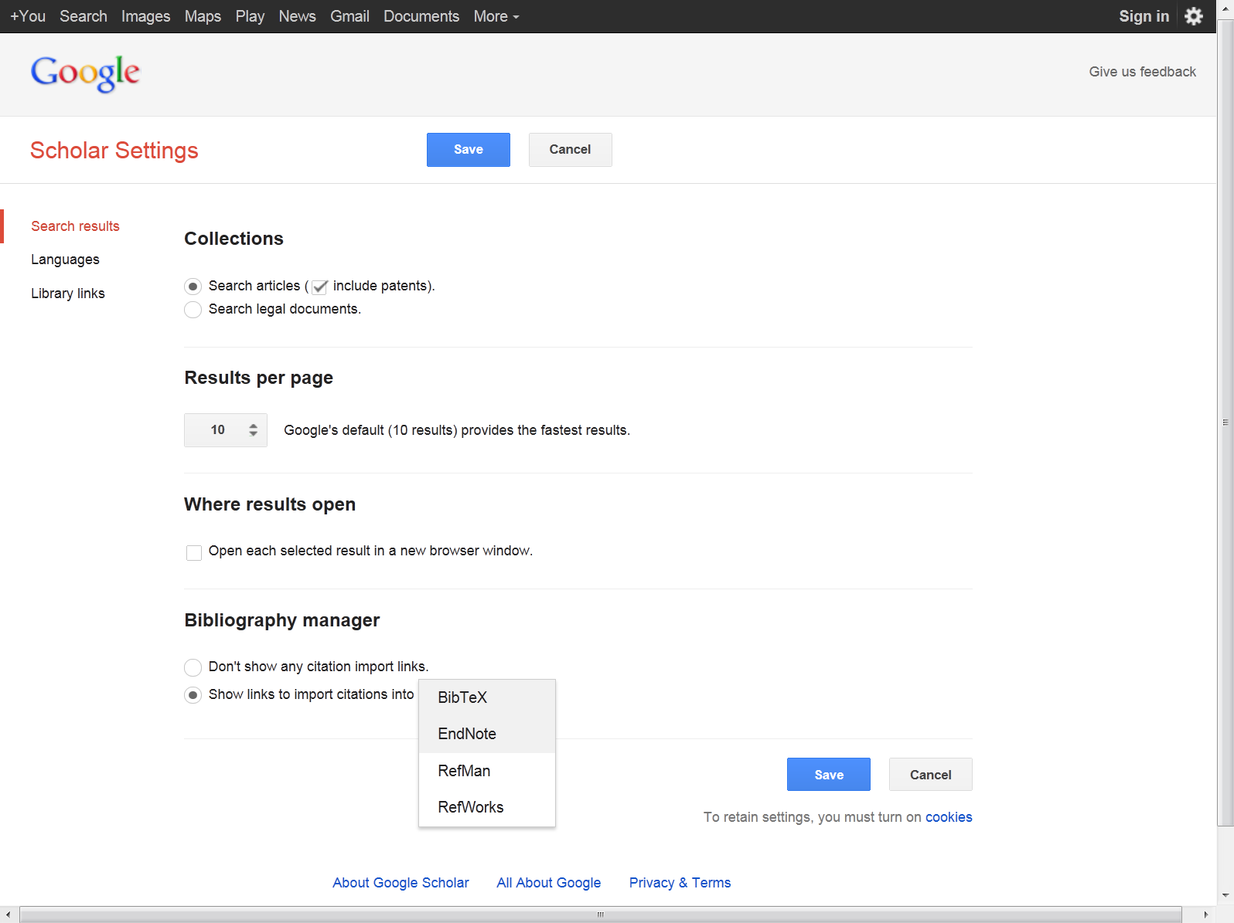
Change Bibliography manager to EndNote

Slide 25
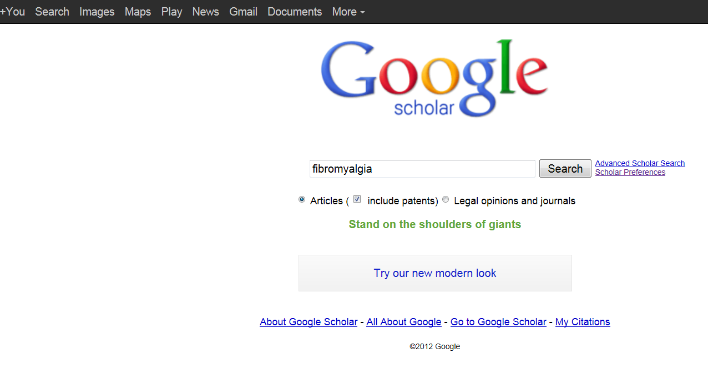
Type in keyword(s) in search box and click Search

Slide 26
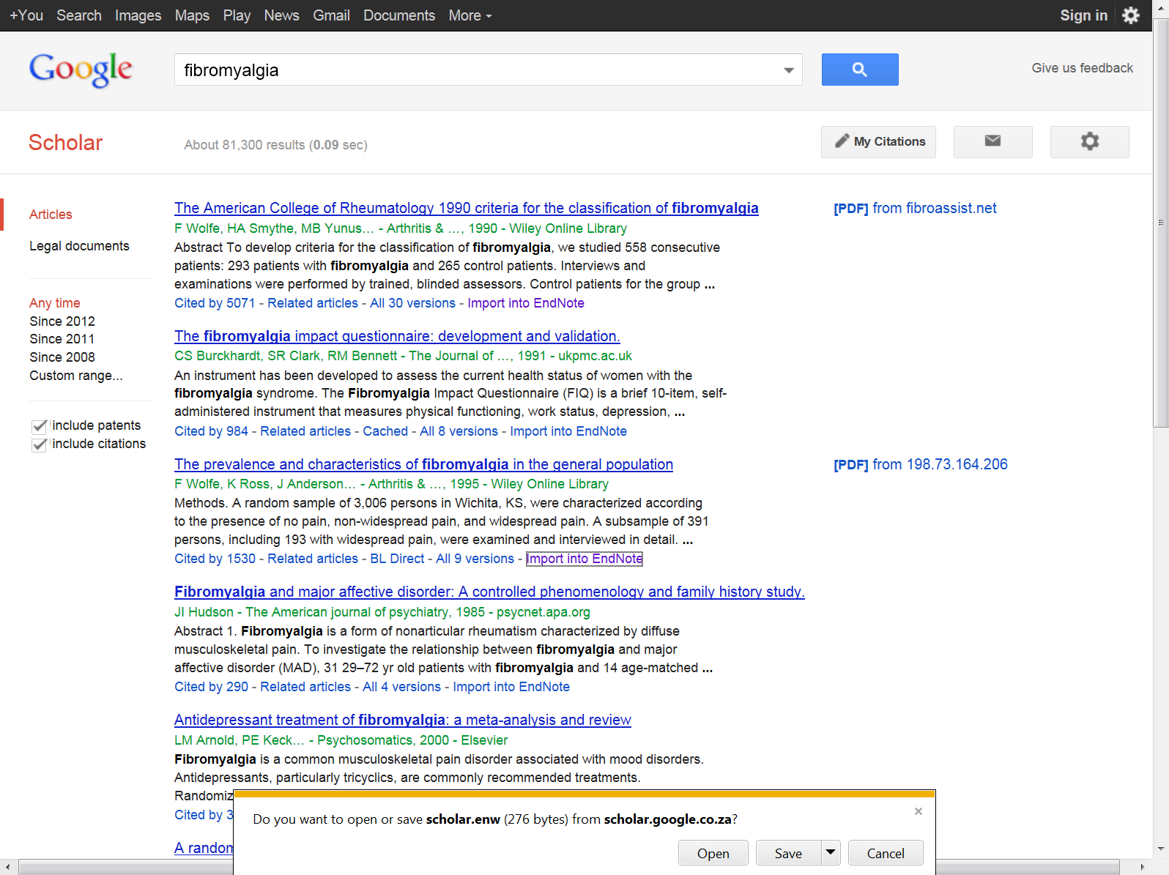

Slide 27
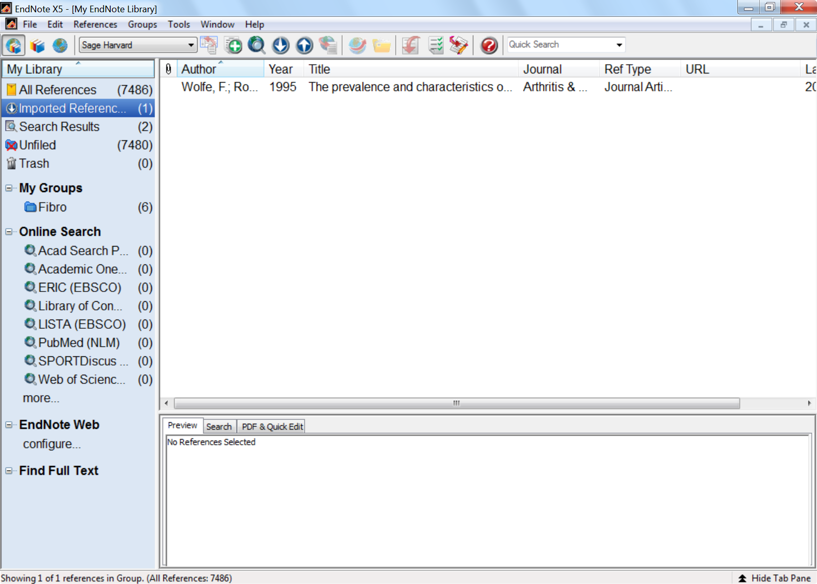
Imported reference from Google Scholar

Slide 28
EXPORT FROM SCIENCEDIRECT TO ENDNOTE

Slide 29
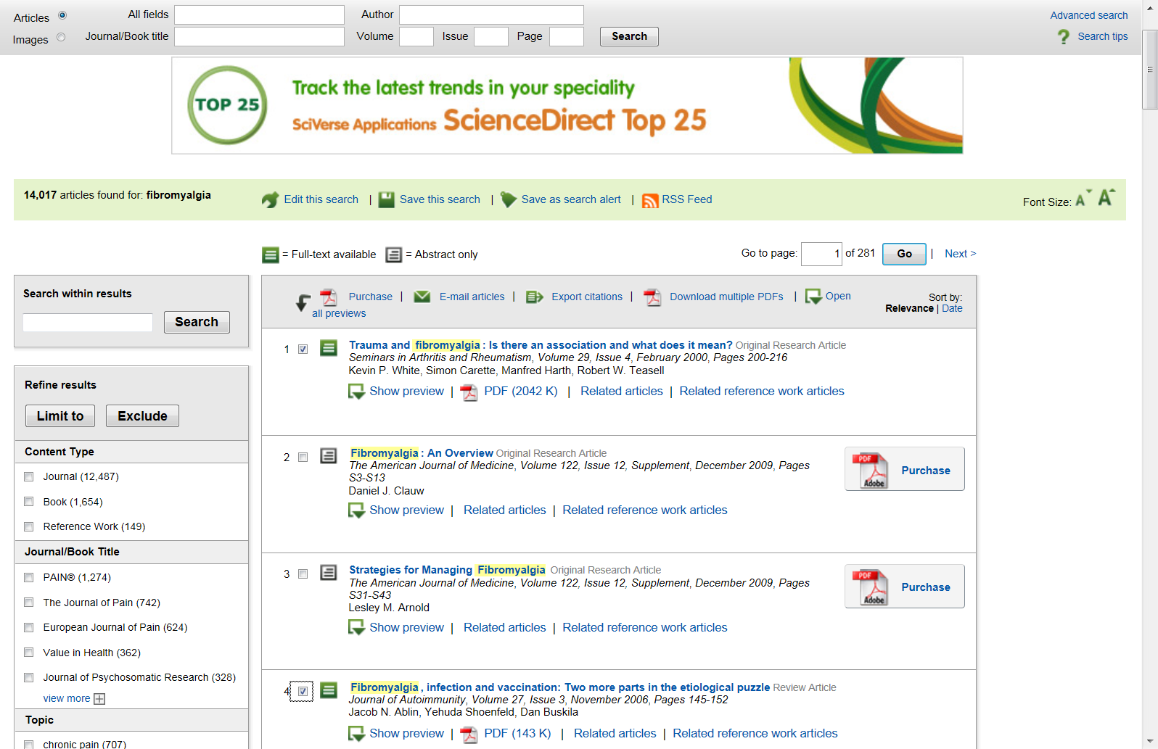
SCIENCEDIRECT SEARCH RESULTS
Select relevant articles

Slide 30
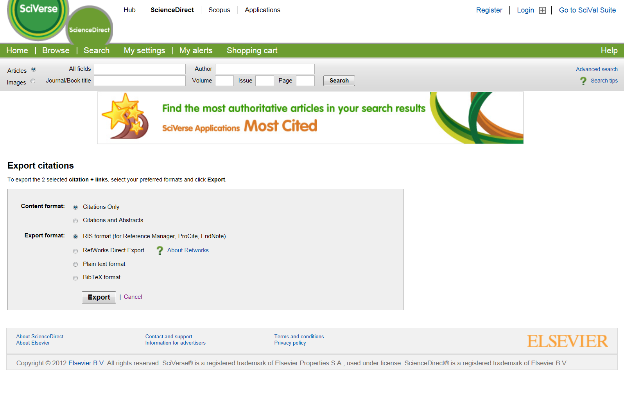

Slide 31
EXPORT FROM ISI WEB OF SCIENCE TO ENDNOTE

Slide 32
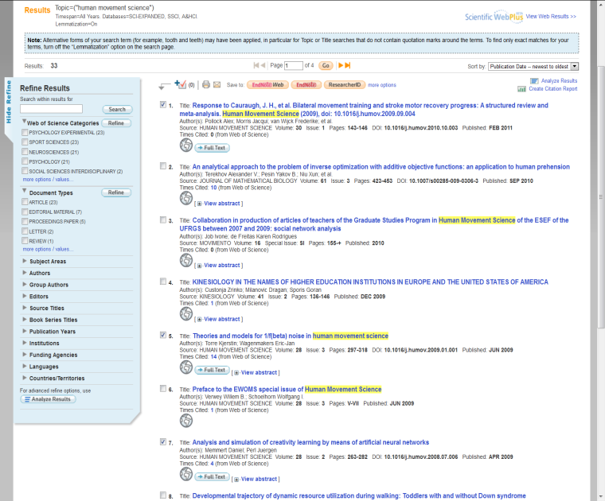
Select relevant articles

Slide 33
